Slide 1

A Probabilistic Seismic Hazard Model for Sub-Saharan Africa
Valerio Poggi¹, Graeme Weatherill¹, Julio Garcia¹, Marco Pagani¹
R. Durrheim², G. Mavonga Tuluka³, A. Nyblade⁴
1 - Global Earthquake Model (GEM), Pavia Italy
2 - University of the Witwatersrand, Johannesburg, South Africa
3 - Goma Volcanic Observatory, DR Congo
4 - Penn State University, USA
June 29, 2016, Addis Ababa - Ethiopia

Slide 2
Introduction and Motivation

Slide 3
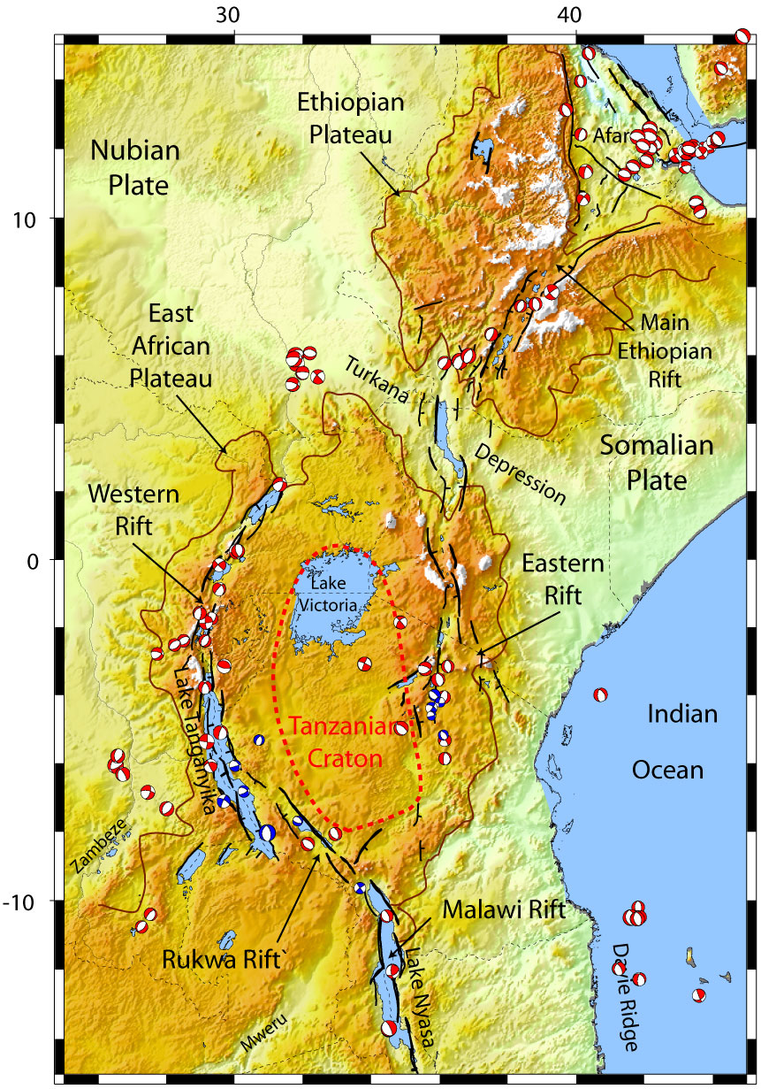
Introduction
The East African Rift System (EARS) is the major active tectonic feature of the Sub-Saharan Africa (SSA) region
Several past large earthquakes caused a non-negligible level of damage
A reliable risk assessment is therefore essential, which requires a state-of-art hazard assessment for the region
We propose an new probabilistic seismic hazard model for SSA based on the most recent and up to date available information

Slide 4
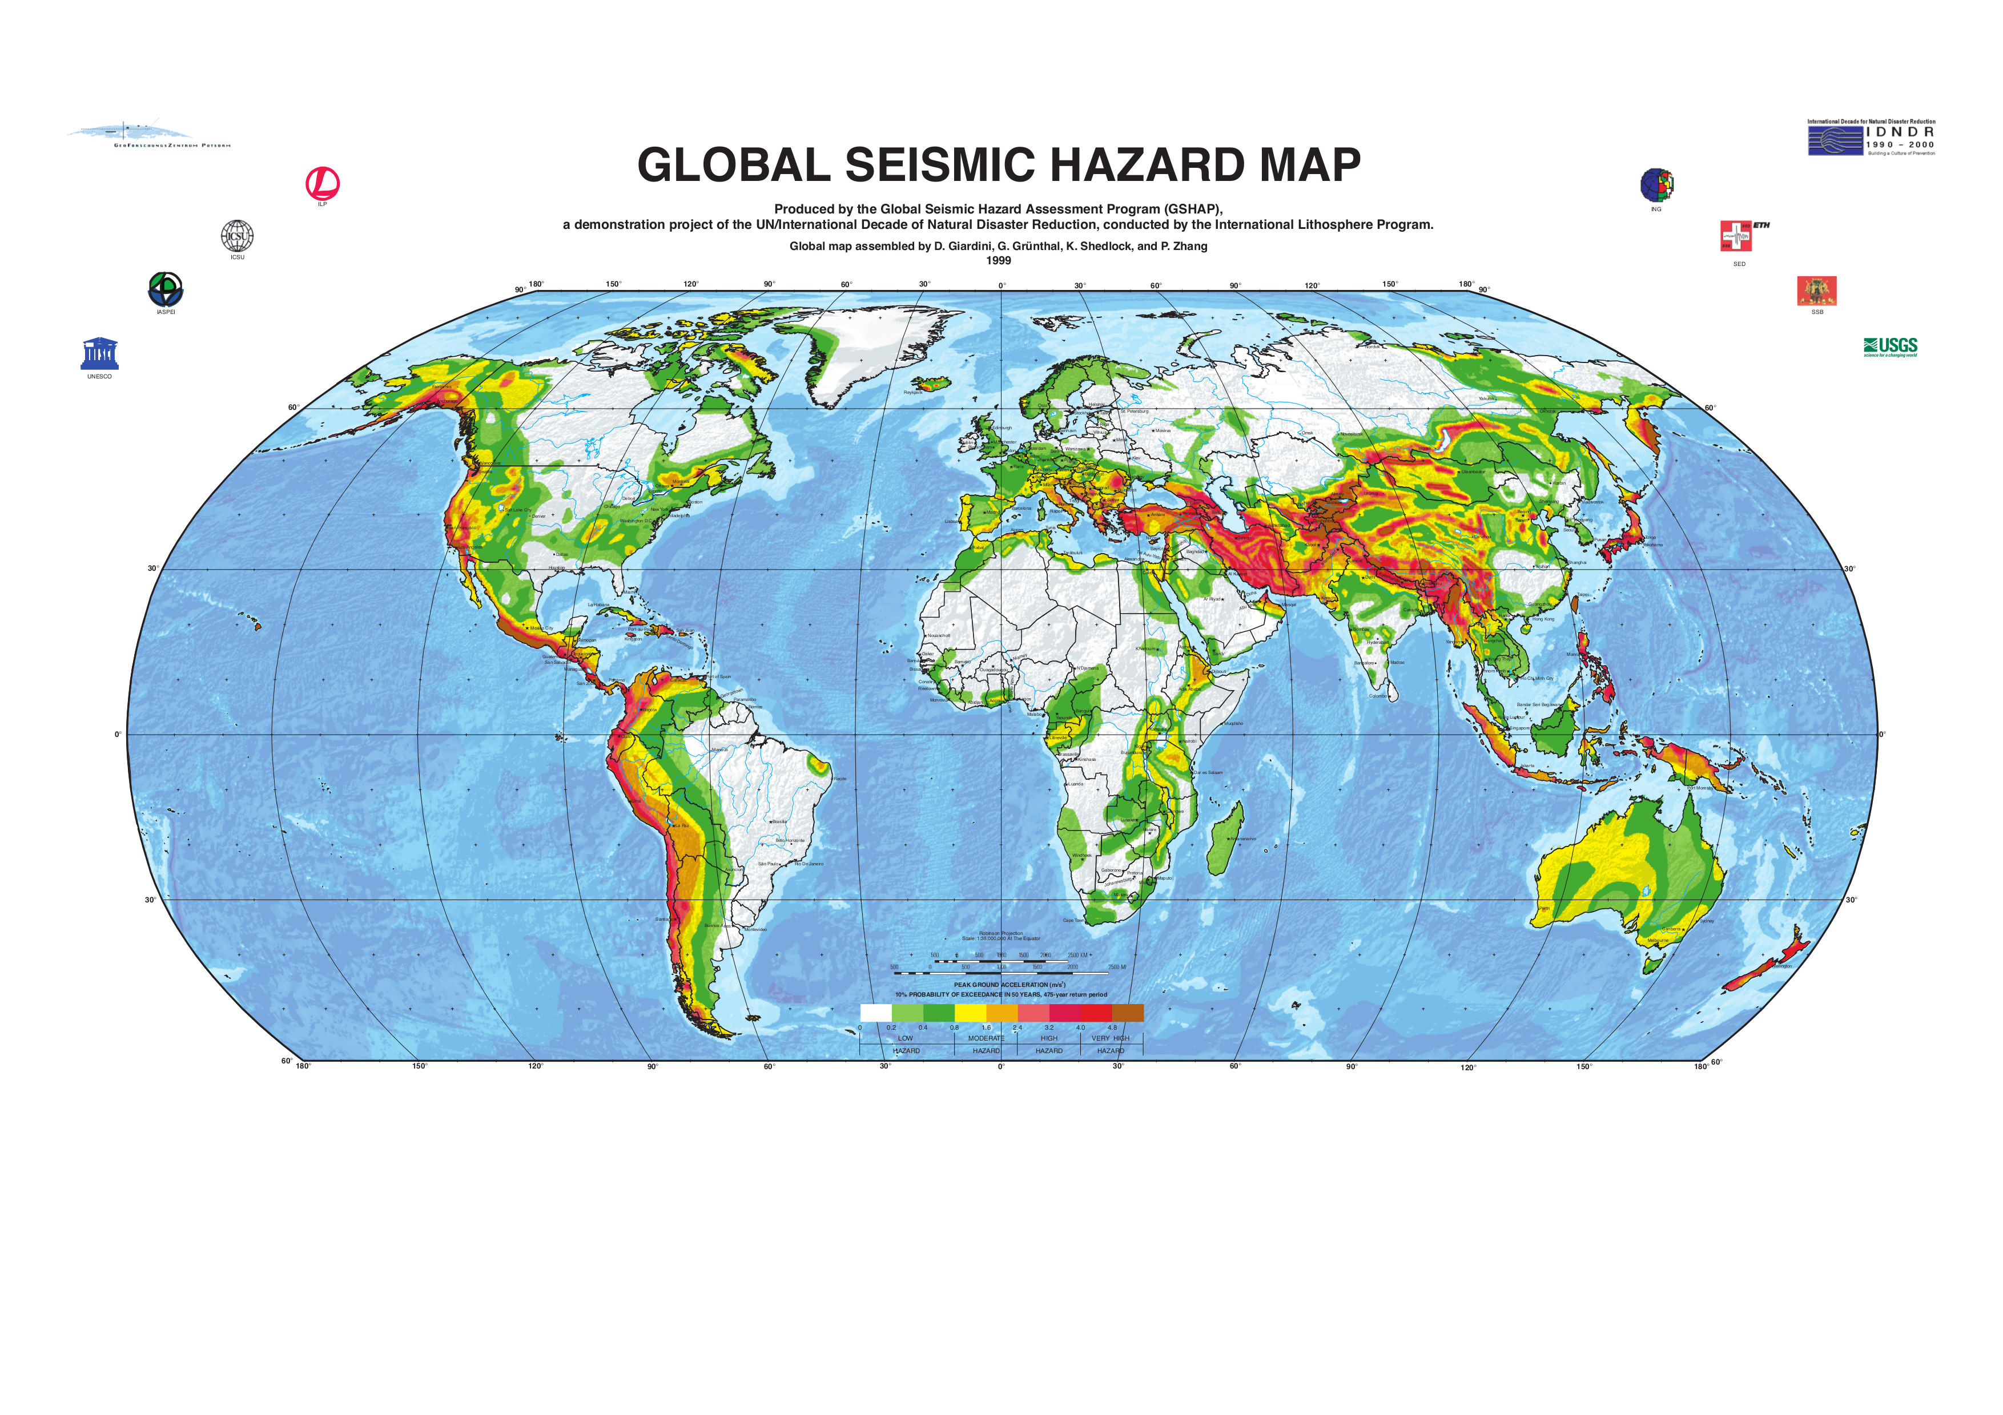
GSHAP Global Model
Global Seismic Hazard Assessment Program (GSHAP) is the only presently available model covering the whole continental Africa

Slide 5
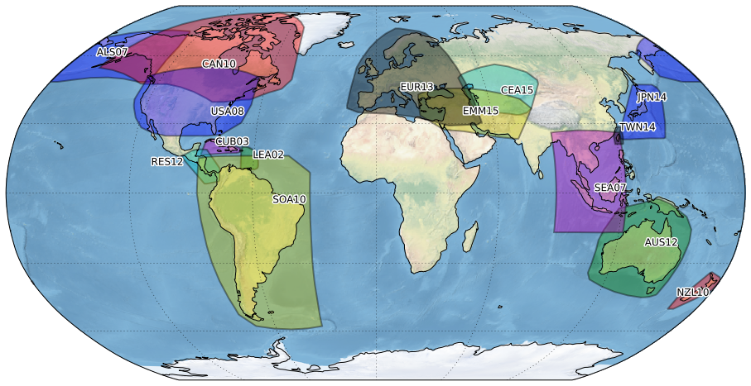
GEM Global Database of Hazard Models
Europe - SHARE
Central
Asia - EMCA
Alaska
Japan
USA
Middle
East - EMME
Cuba
Central
America
Lesser
Antilles
Taiwan
South America
SSAHARA
South East Asia
New
Zealand
Our goal is the construction of an OPEN DATABASE of hazard models developed by national agencies and international projects

Slide 6


GEM’s Philosophy
The Sub-Saharan Africa Hazard Model (as for all GEM products) is meant to be:
1) Collaborative
Although the initial pilot model has been proposed by GEM, we promote its development through collaboration between scientists from African institutions and worldwide
2) Open and transparent
All input information (e.g. catalogue), data (configuration files) and results are openly accessible to the community for verification, improvement or any use

Slide 7
GEM – SSA Hazard Model
Presently available PSHA Model Components:
Earthquake Catalogue
Agency Selection
Magnitude Homogenization
Declustering
Source Zonation
Seismicity Analysis (for area sources):
Completeness & MFD Parameters
Depth Distribution
Source Mechanism
Rate Balance
GMPE Selection
Logic Tree Implementation & Uncertainty
PSHA Calculations & Results

Slide 8
The new SSA Earthquake Catalogue

Slide 9
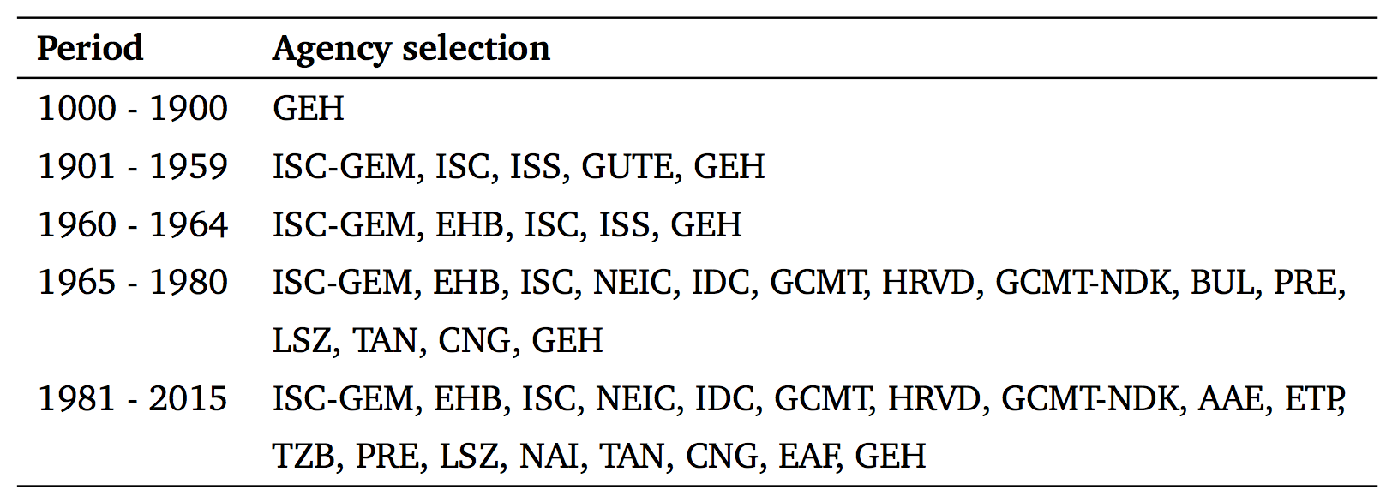
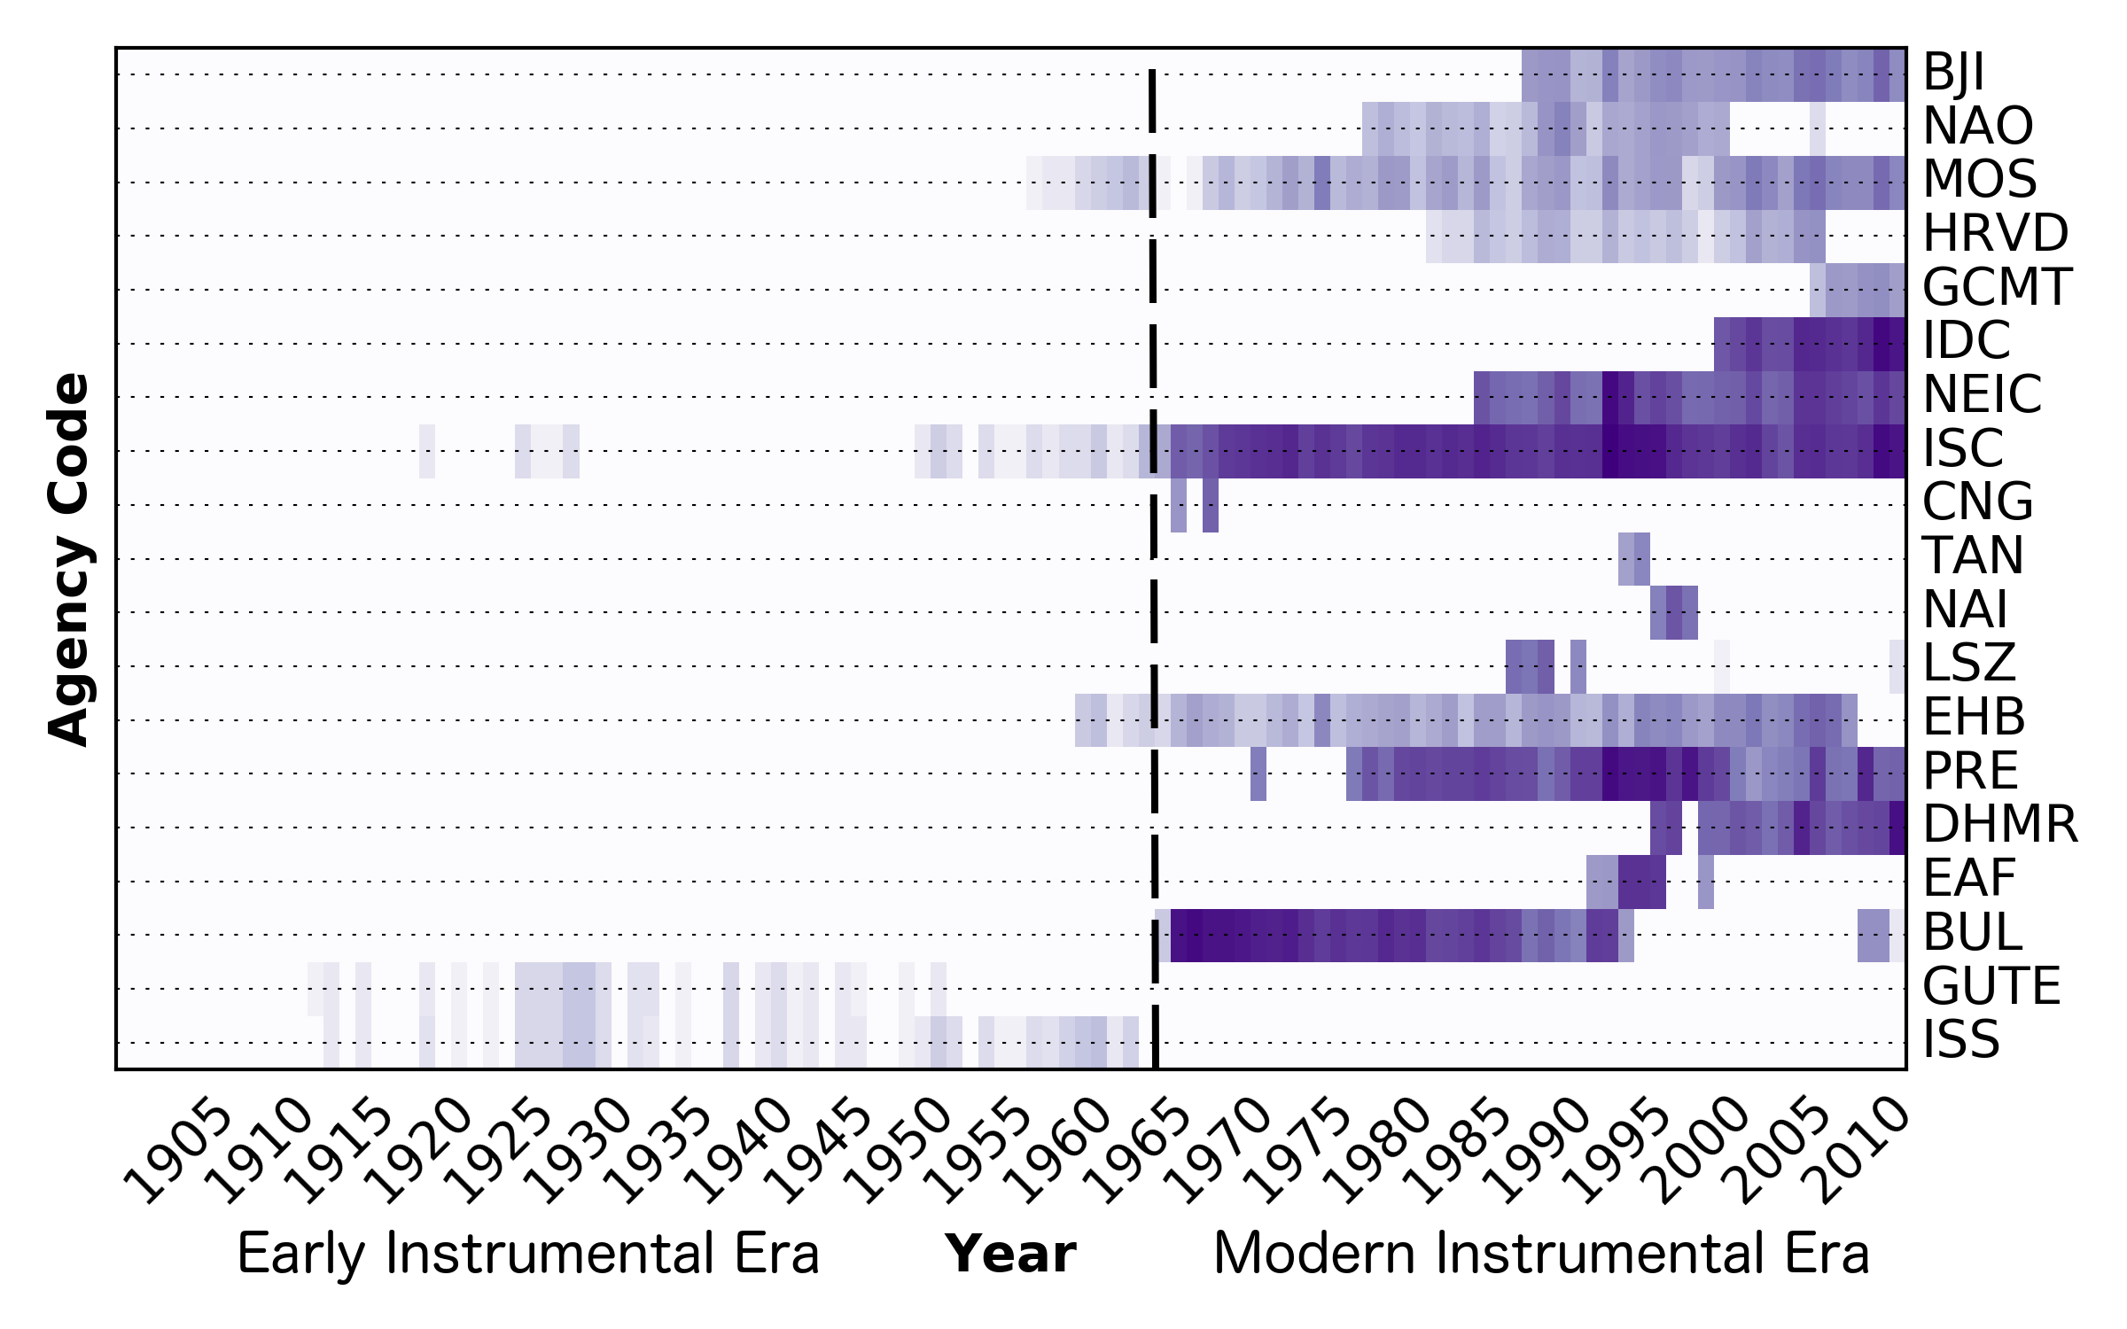
Merging Earthquake Catalogues
Agency Prioritization
Input Catalogues:
ISC-REV
ISC-GEM
GCMT
GEH
AfricaArray
Agency Selection
Tanzanian Broadband Seismic Experiment (TZB)
Ethiopian Plateau Catalogue (ETP)
AfricaArray Eastern Africa Seismic experiment (AAE)

Slide 10
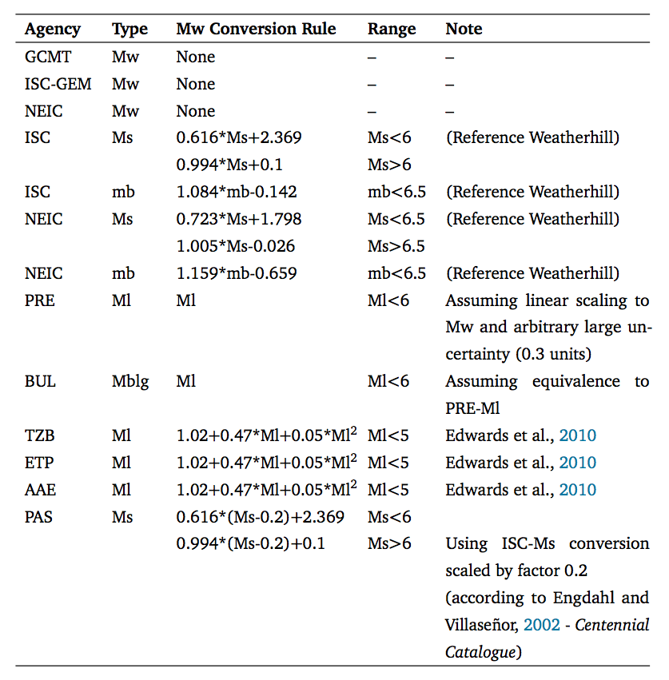
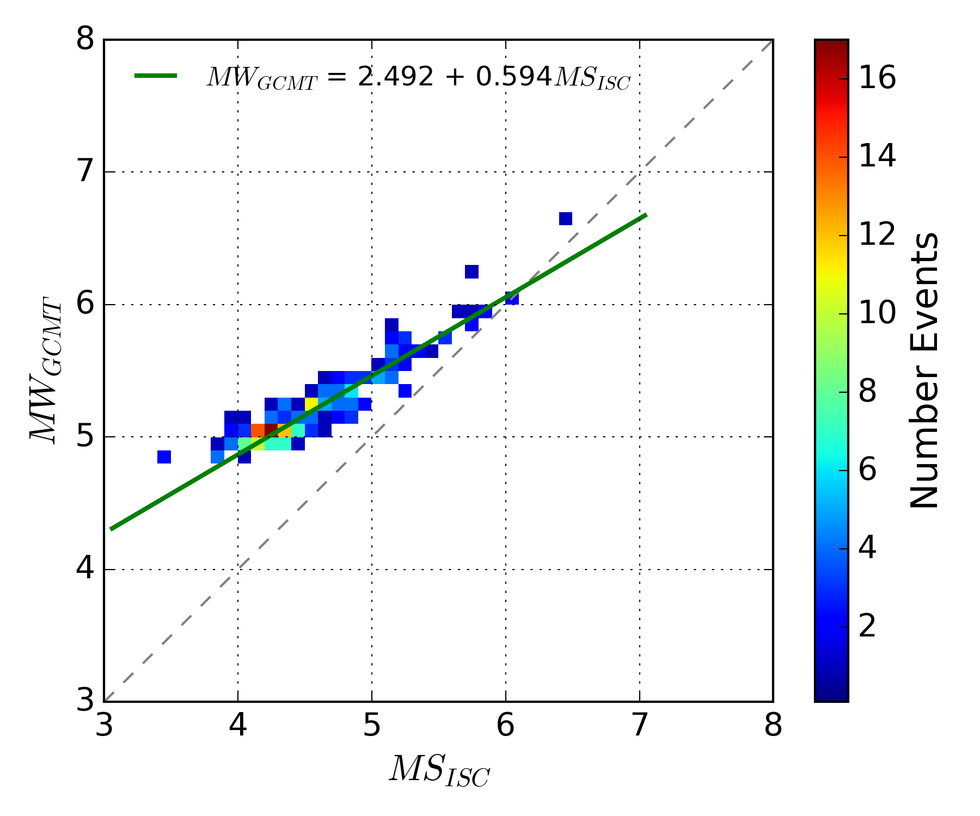
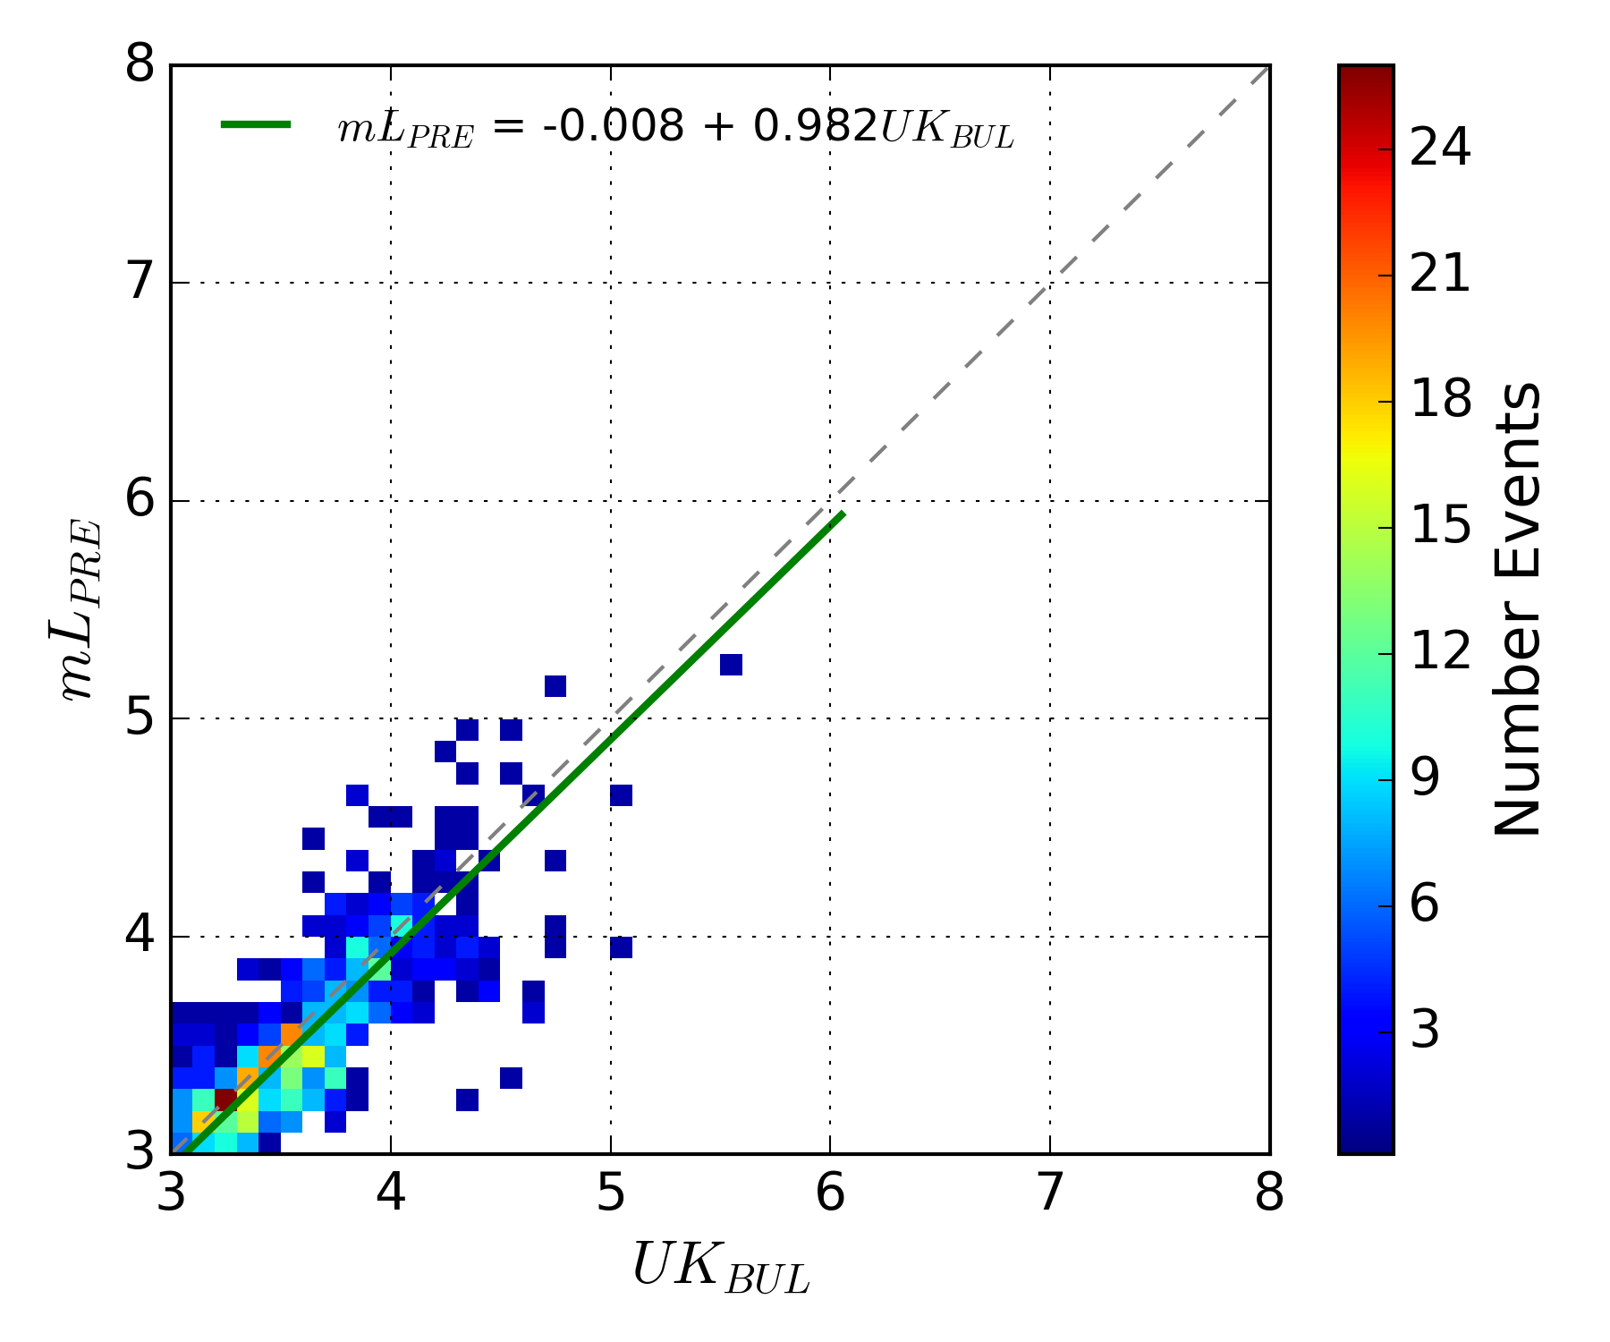
Magnitude Homogenization
Examples

Slide 11
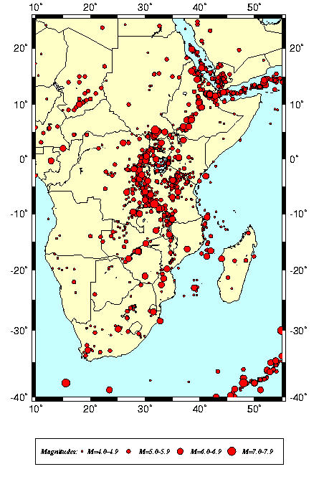
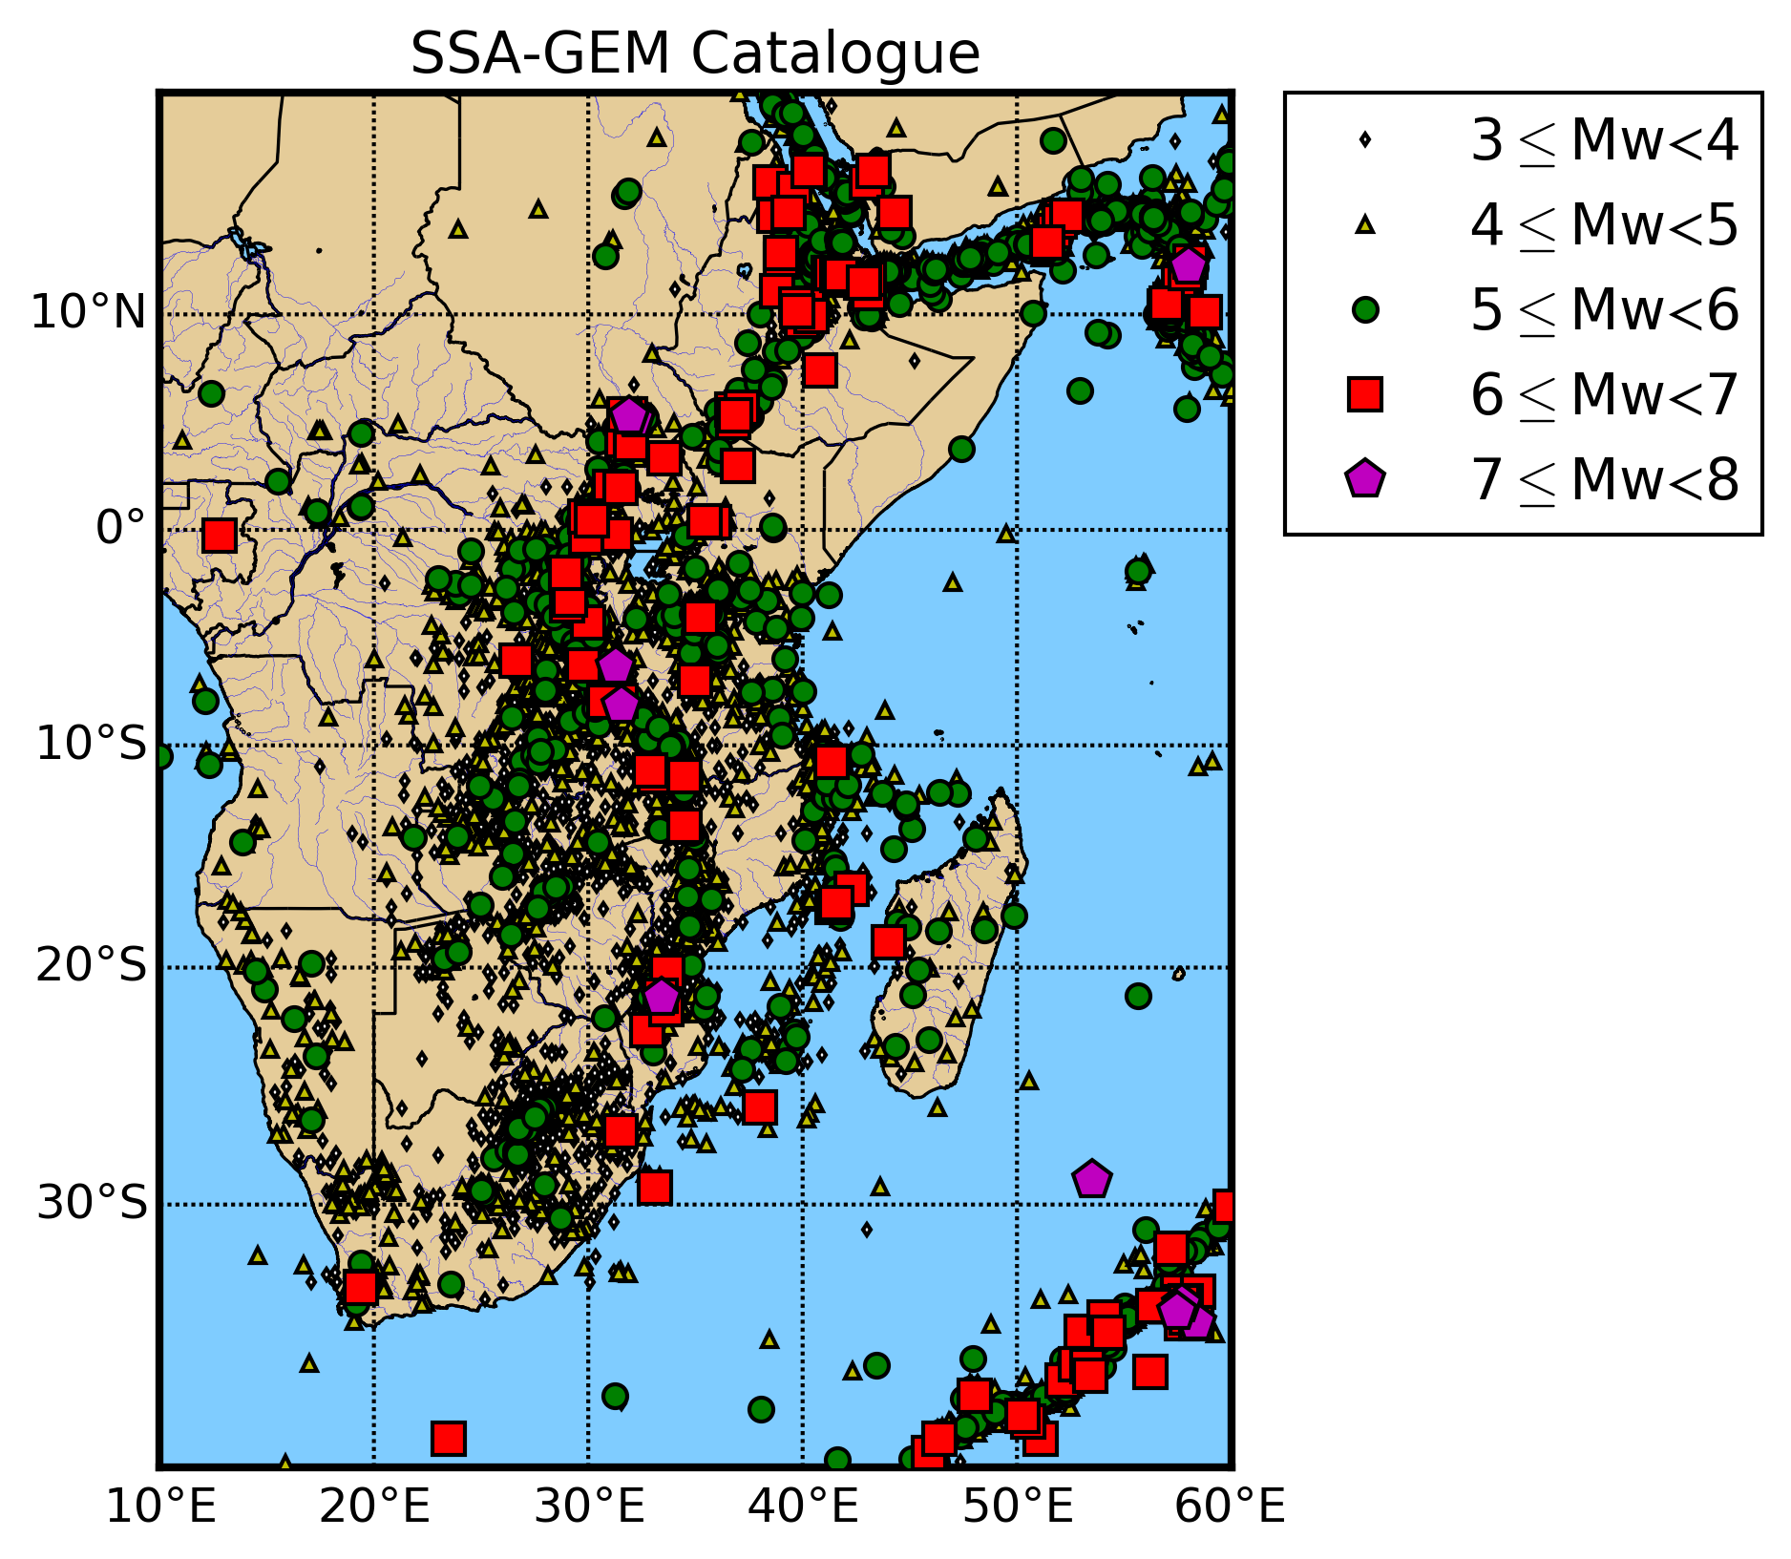
SSA Earthquake Catalogue
GSHAP
NEW!
29803 events
3 ≤ Mw ≤ 7.53

Slide 12
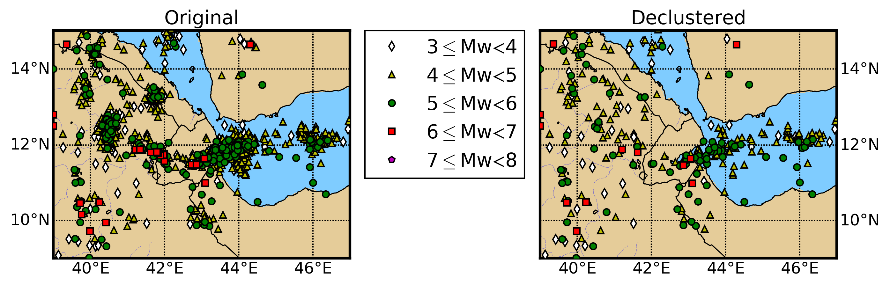
SSA Catalogue Declustering
To obtain estimates of stationary seismicity rates the recurrence models need to be fit to earthquake catalogues that are purged of non-Poissonian Events (i.e. foreshocks and aftershocks) which are dependent
We use Gardner & Knopoff (1974) algorithm
7259 events out of the original 29803 (3 ≤ Mw ≤ 7.5)

Slide 13
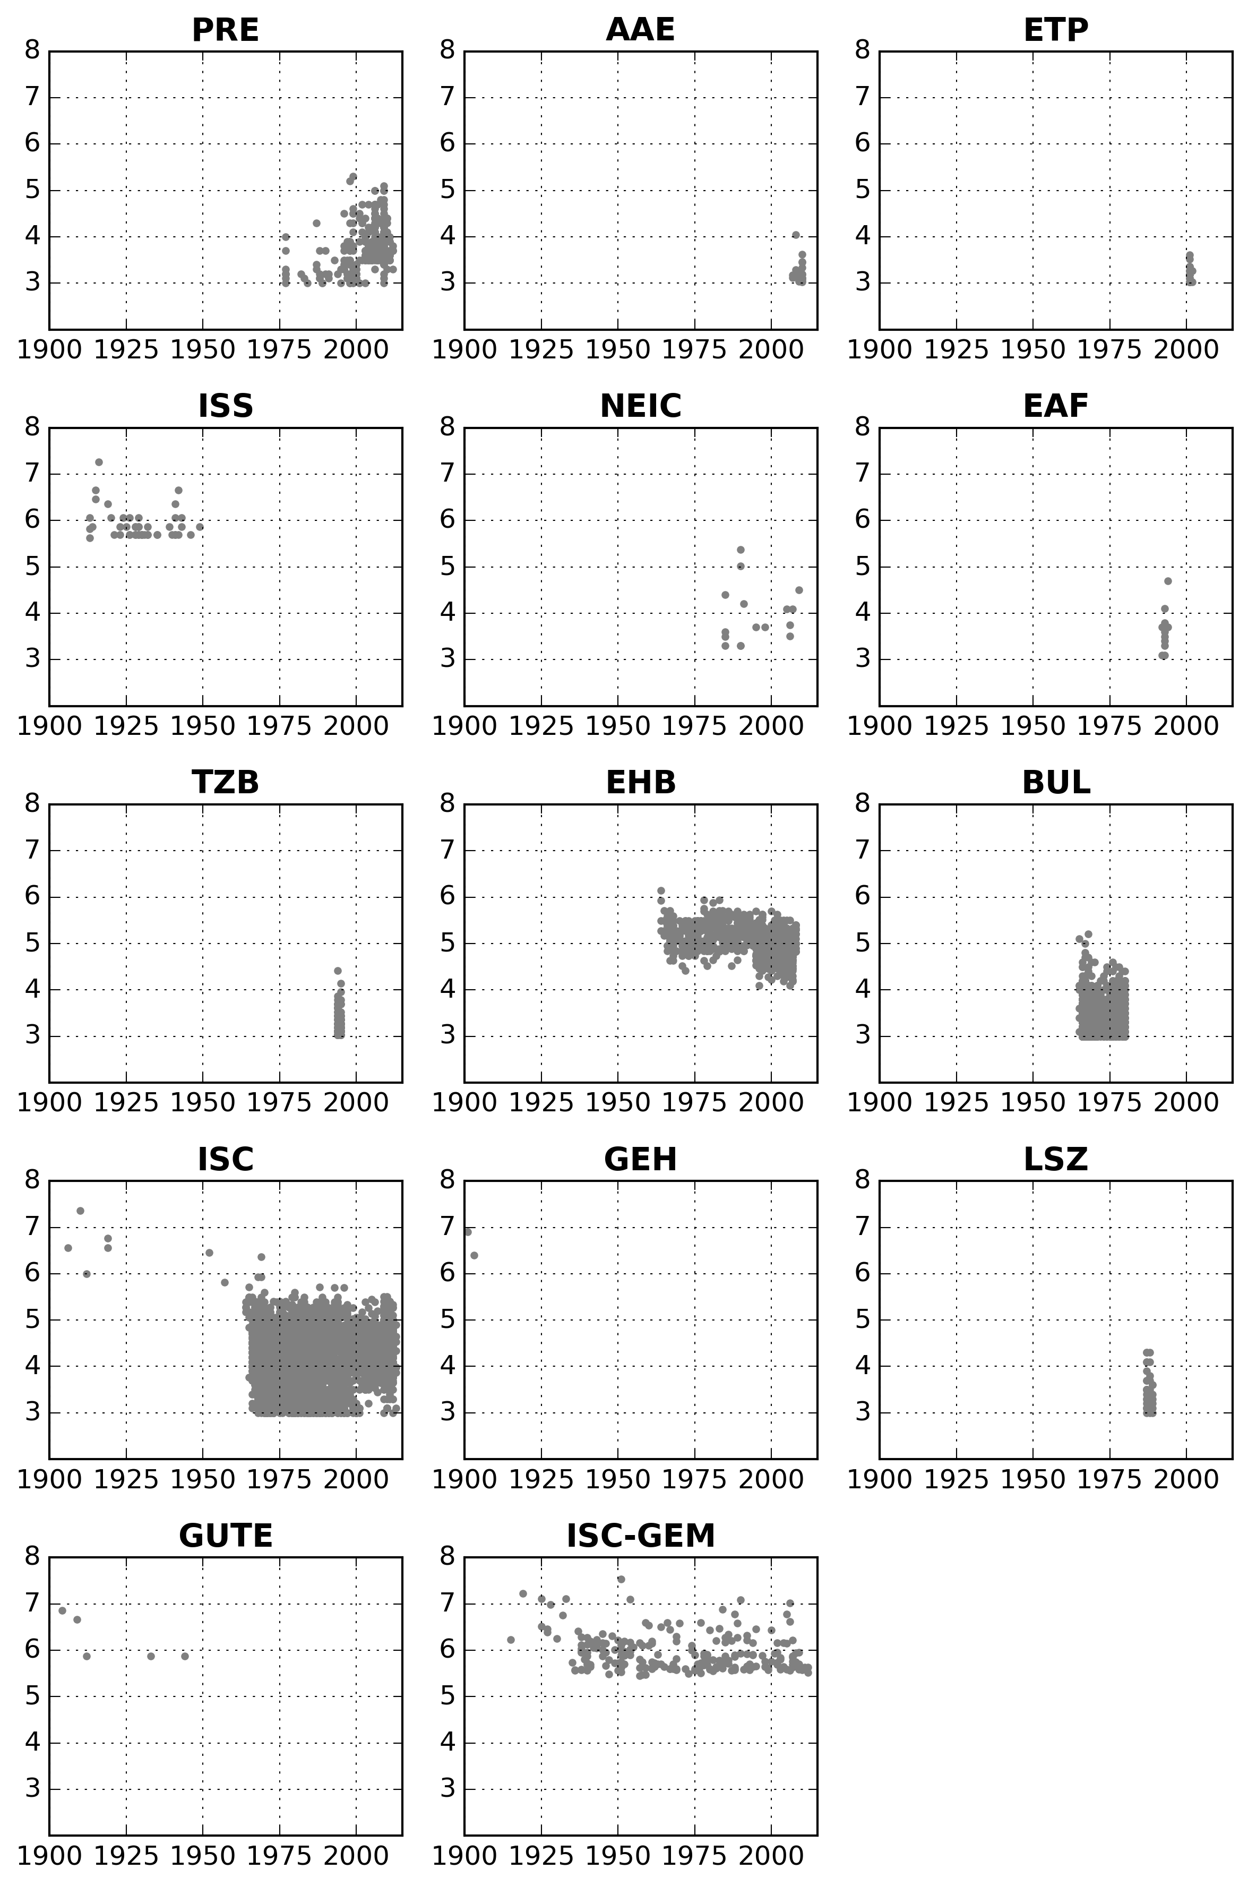
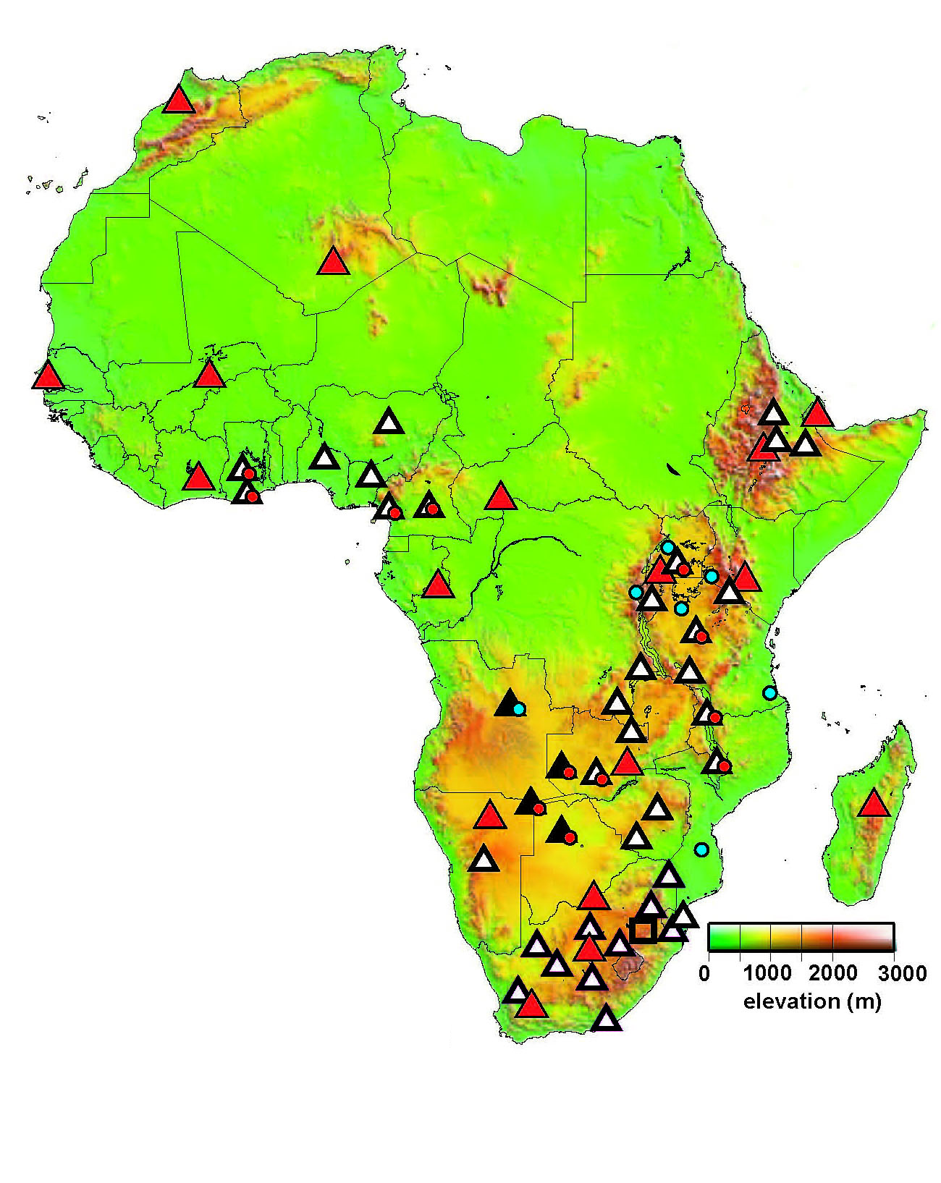
Accessing Relative Agency Contribution
DECLUSTERED
SSA CATALOGUE
Were AfricaArray data of any significance?
YES, but not for seismicity analysis…..
AfricaArray
Data Integration

Slide 14
Area Source Zonation

Slide 15
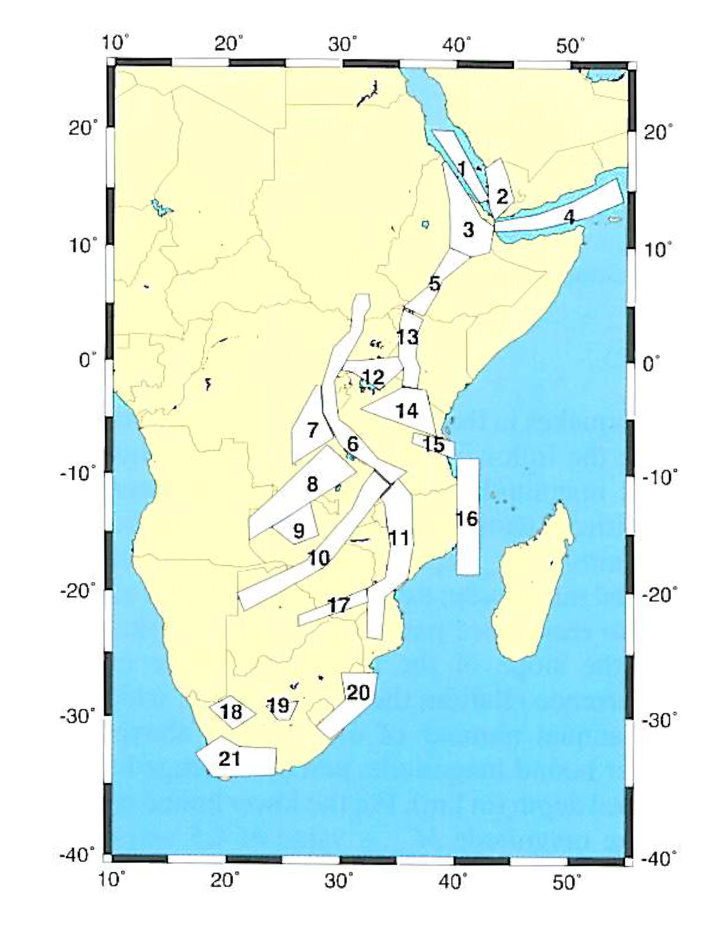
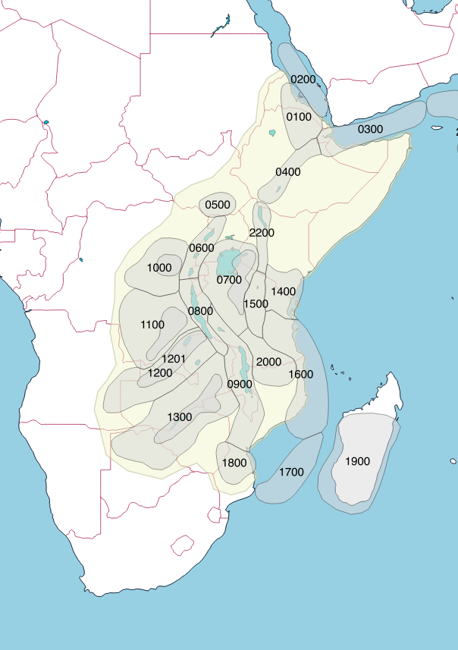
Area Source Zonation
GEM - Version 6.0
GSHAP
Based on:
Previous studies
Seismicity
Surface Faults
Plate boundaries
Strain models

Slide 16
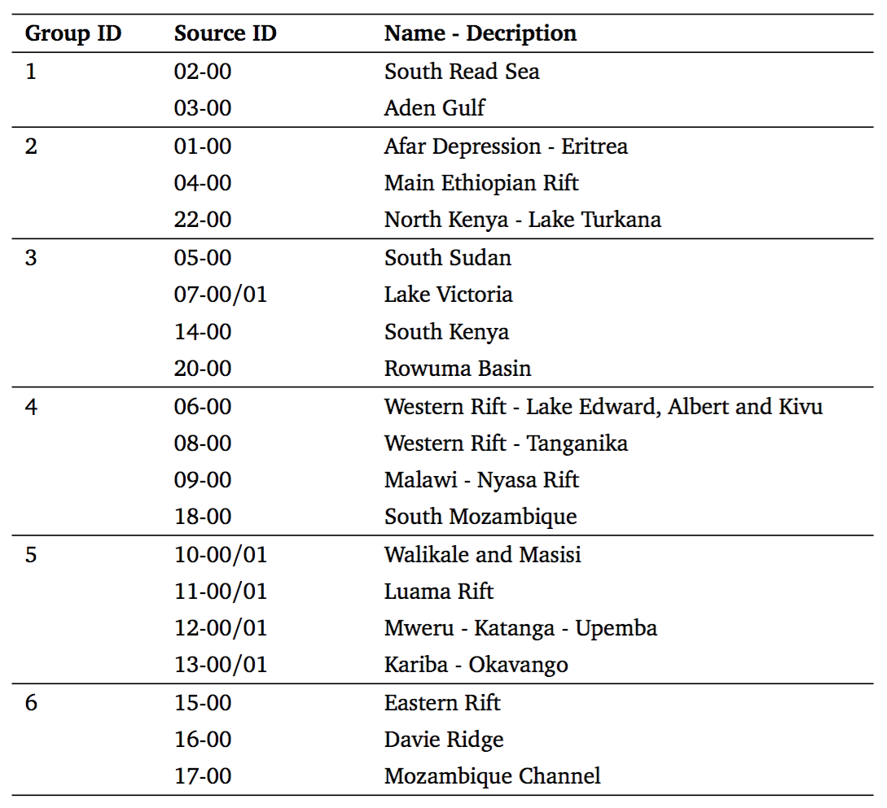
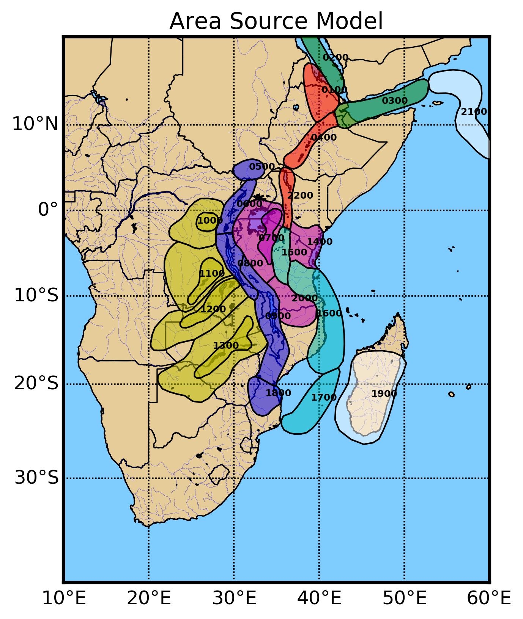
Source Groups

Slide 17
Multiple Layer Strategy
An overlapping layer inherits the characteristics (completeness, b-value, source geometry) of the background
Rates are redistributed by keeping the total rate balance unmodified
Overlapping Layer
Zone XX.01
Calibration Layer
Zone XX.00
Background Layer

Slide 18
Source Parameters

Slide 19
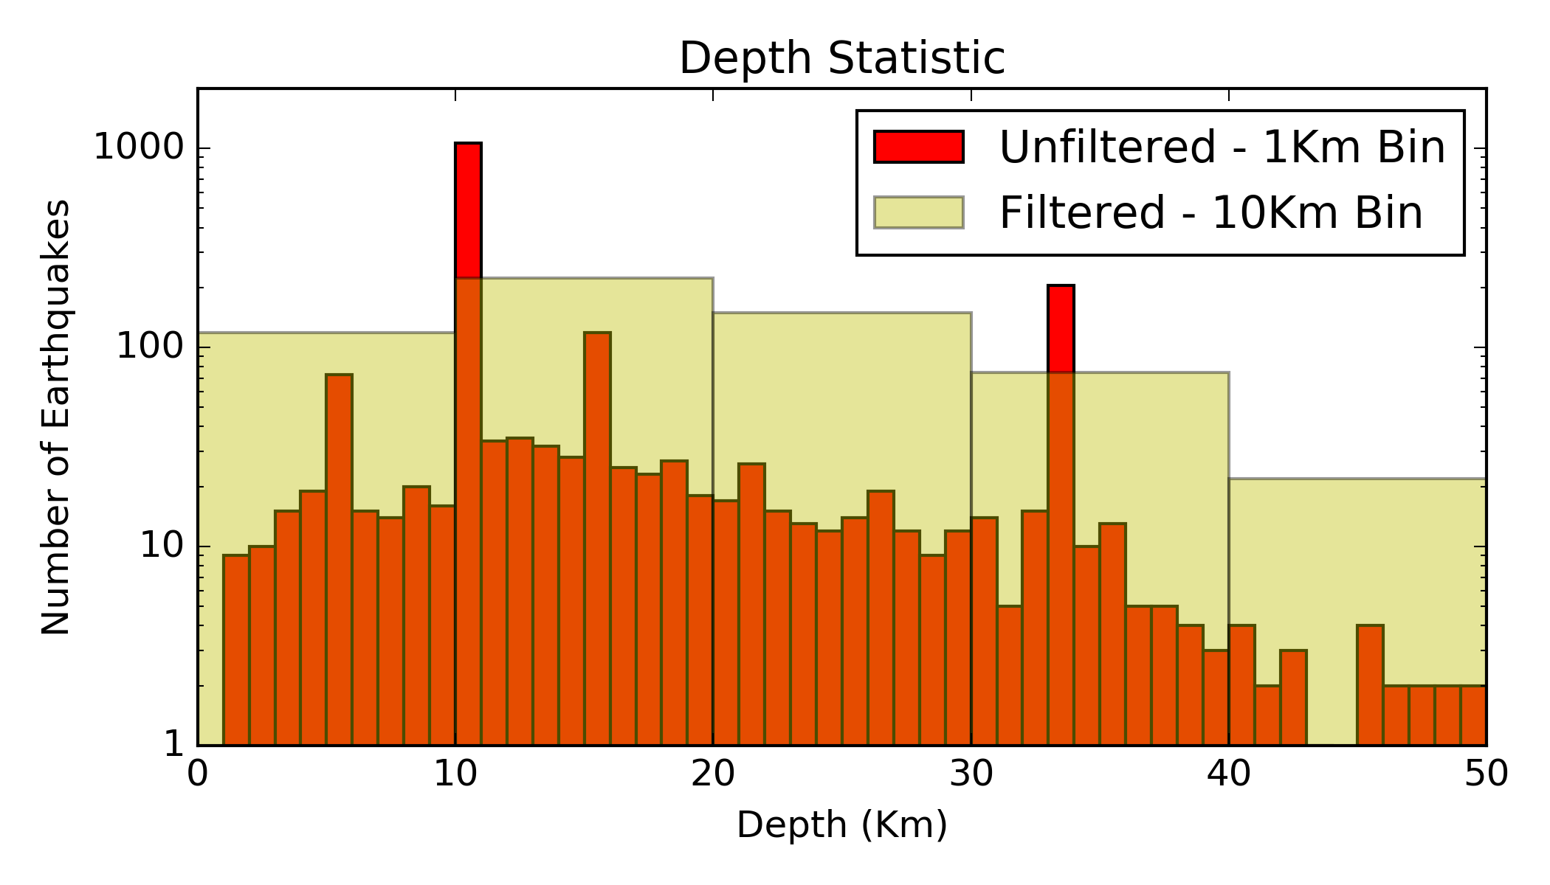
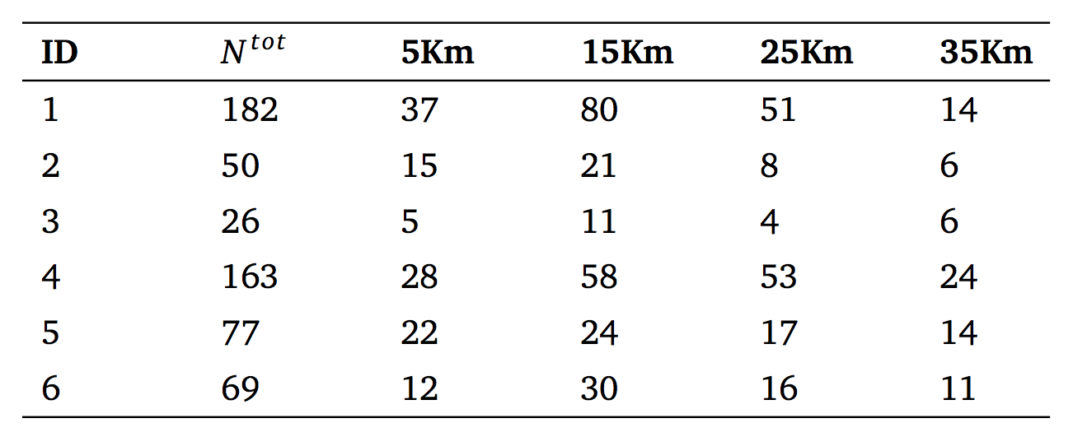
Depth Solution Distribution
⬇
Fix-Depth Solutions Removed
⬇
⬇
⬅
Uncertain
Large-Depth
Solutions Removed
Final
Statistic

Slide 20
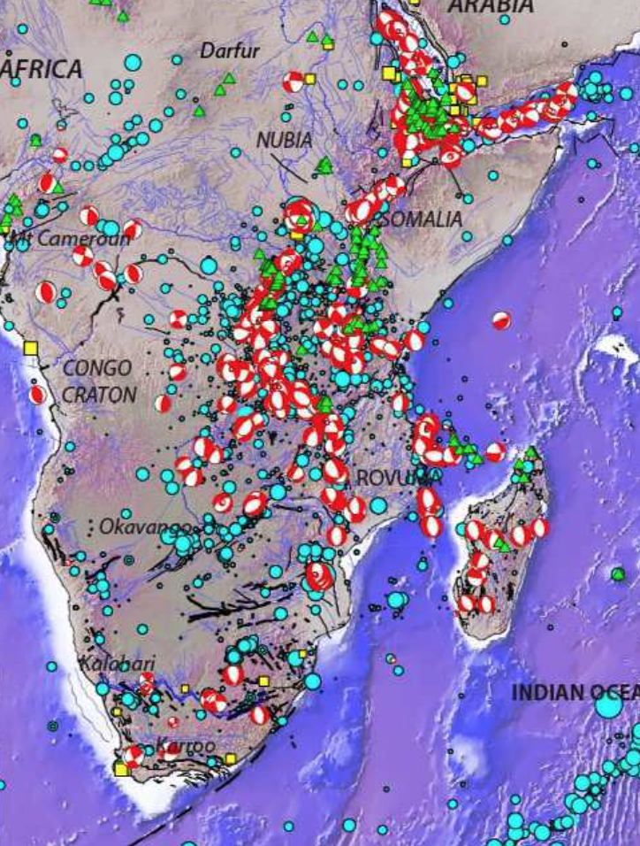
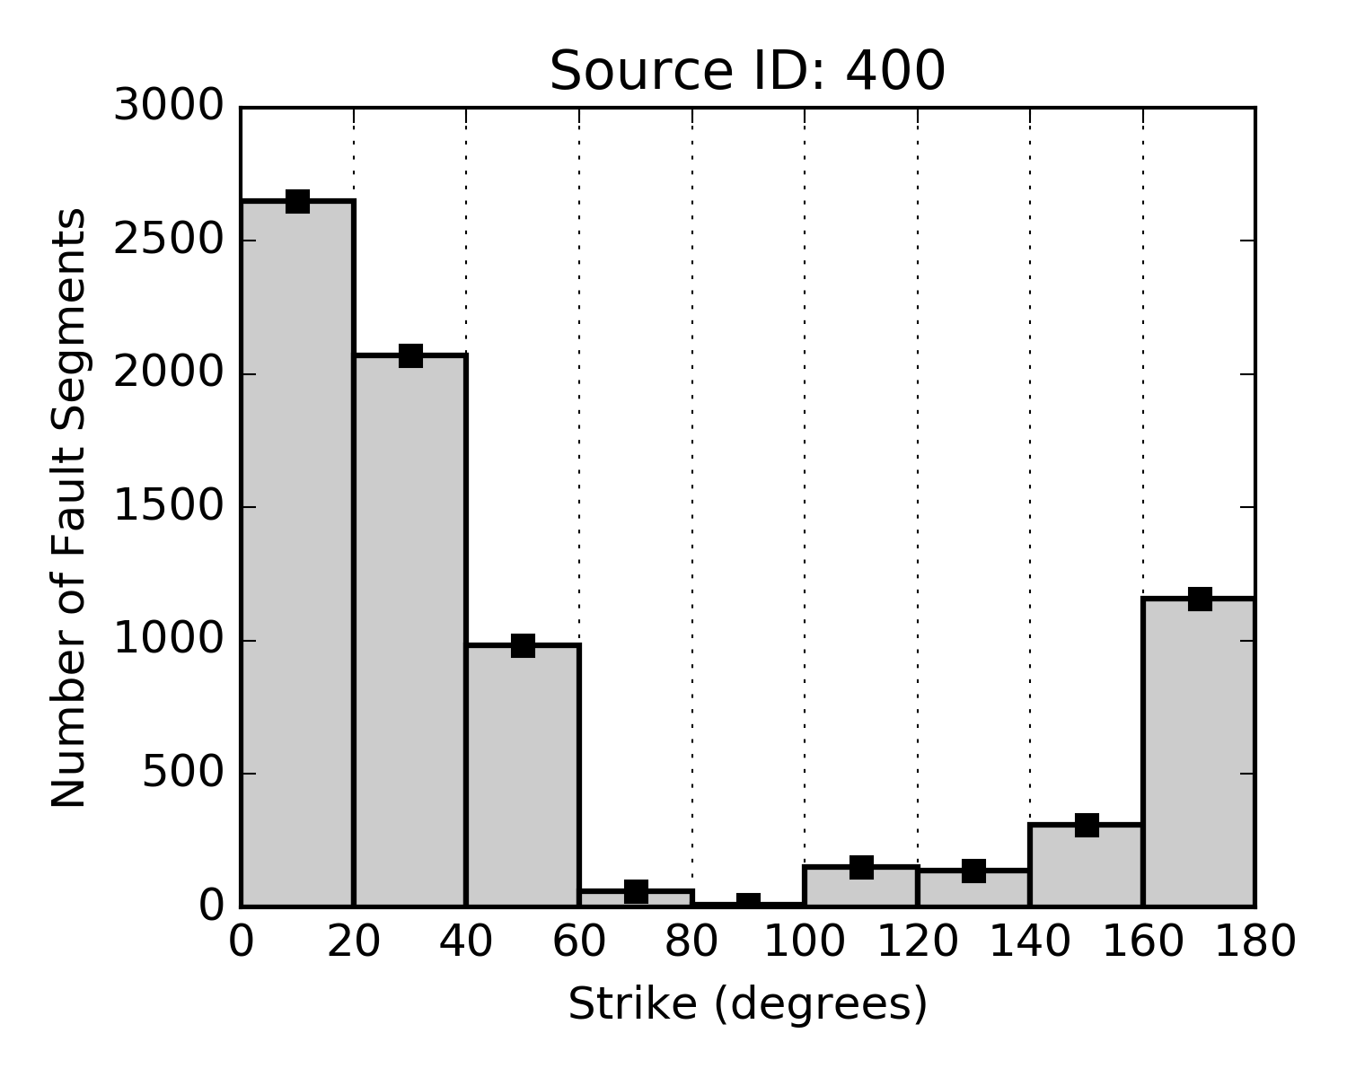
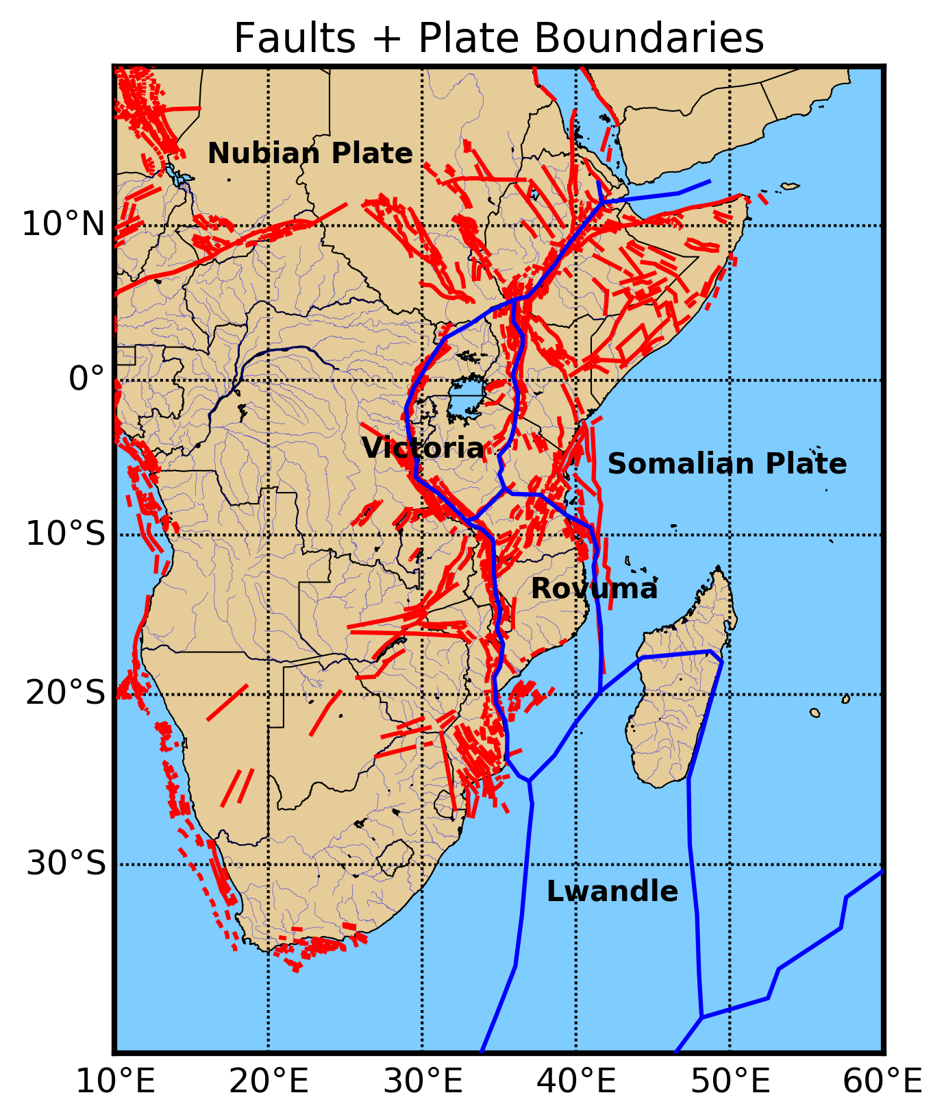
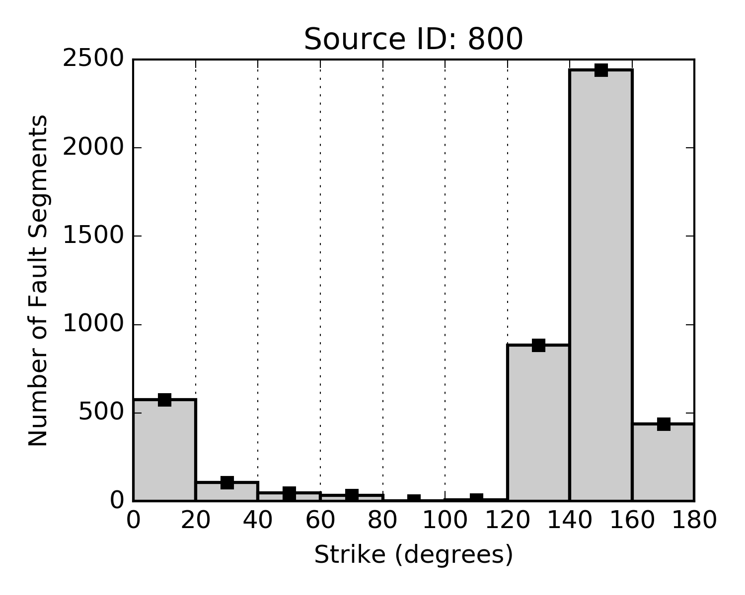
Source Mechanism Statistic
Bibliographic information + open datasets
Strike Distribution
Fault Style
(Dip+Rake)

Slide 21
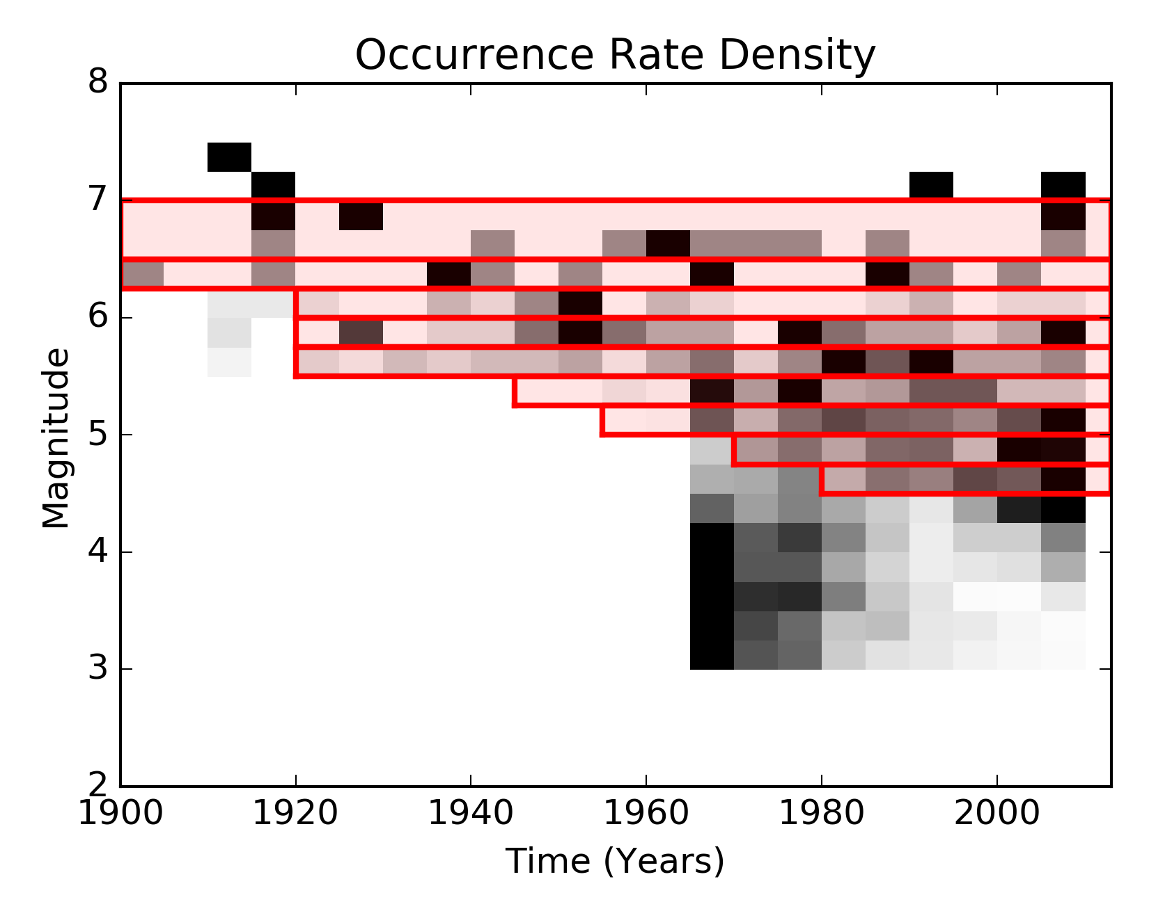
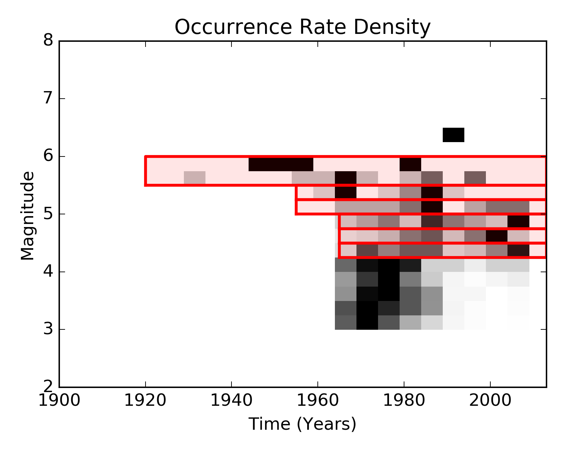
Catalogue Completeness Analysis
SSA Full Catalogue
First, a regional completeness analysis was performed
Source groups have been subsequently refined to account for spatial variability
Alternative methods (e.g. Stepp, 1997) were also tested
Regional Threshold
Source Group 5
comp_table = [[4.50, 0.25, 1967., 2013.],
[4.75, 0.25, 1967., 2013.],
[5.00, 0.25, 1967., 2013.],
[5.25, 0.25, 1967., 2013.],
[5.50, 0.50, 1951., 2013.],
[6.00, 0.50, 1901., 2013.],
[6.50, 1.00, 1901., 2013.]]
Regional Threshold

Slide 22
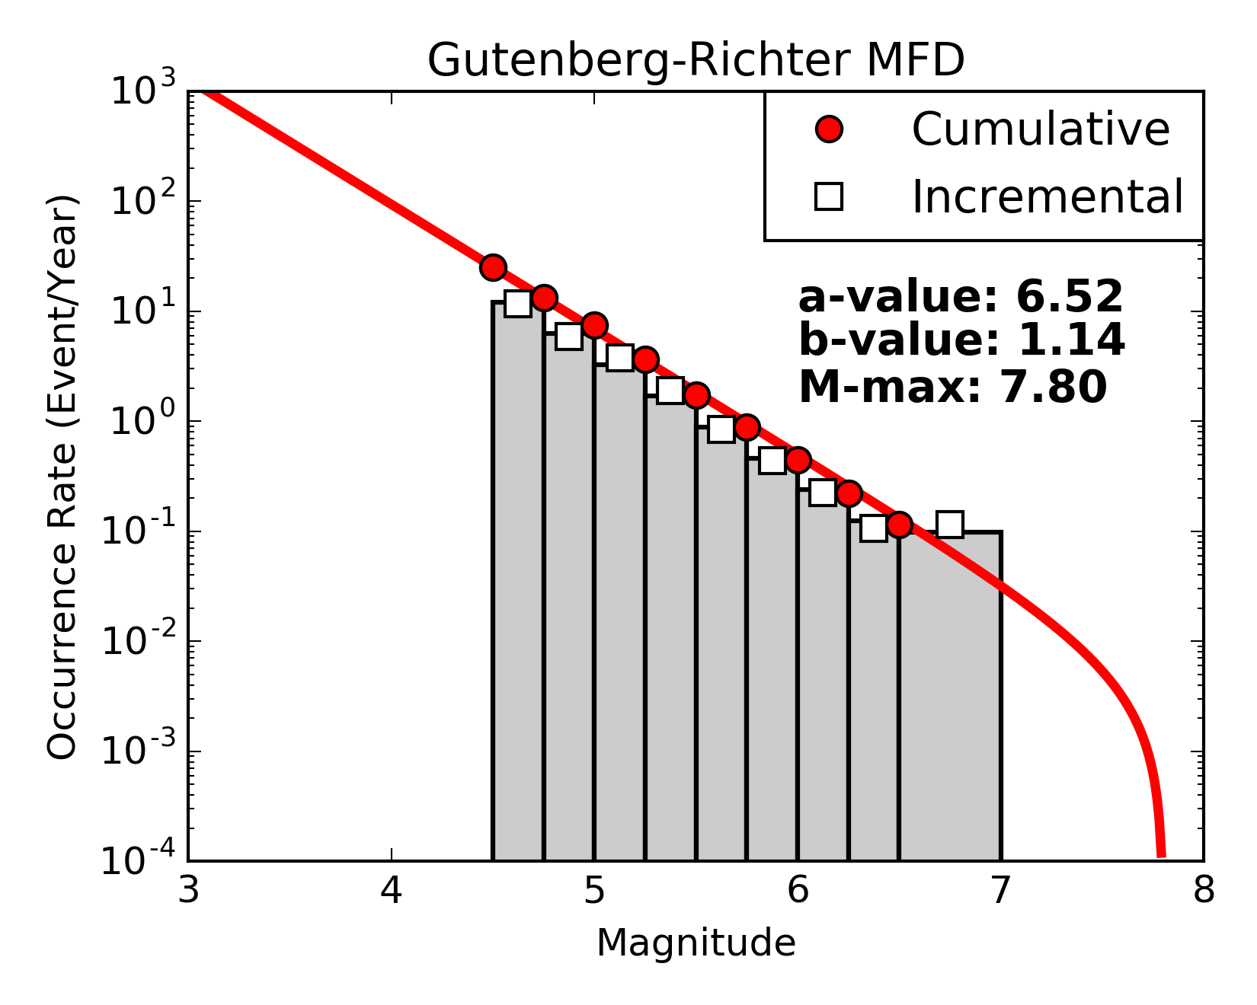
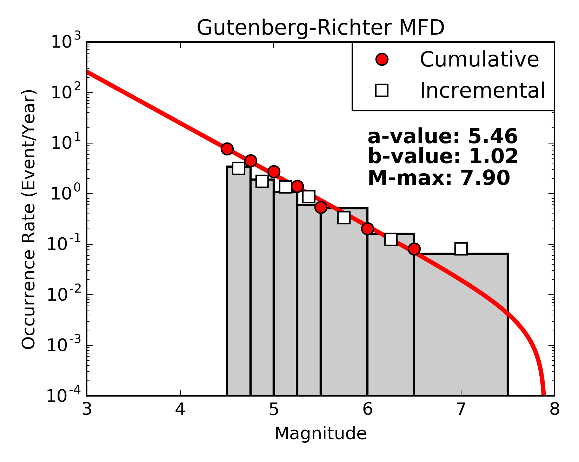
MFD – Seismicity Analysis
Using a truncated Gutenberg- Richter magnitude occurrence relation with
Mw^{min} = 4.5
SSA Full Catalogue
New strategy based on direct inversion of observed incremental occurrences rates
Not affected by data correlation
Bins of arbitrary width / completeness
Either a, b or Mw^{max} can be fixed
Source Group 4

Slide 23
MFD – Seismicity Analysis
The b-values were kept constant within source groups, while the rates have been calibrated separately for each source zone
Rates have been redistributed between overlapping layers by preserving the total balance of the zone
Maximum magnitude was defined based on the maximum observed magnitude for the zone, plus about 0.5 magnitude units
Group | a | b | Mw^{max}
1 | 5.4629809325 | 1.0233537813 | 7.2
2 | 4.7012917208 | 0.9472904903 | 7.5
3 | 4.6964659876 | 1.0215313804 | 6.9
4 | 5.4566139474 | 1.0154006974 | 7.9
5 | 4.9062300341 | 0.9914650334 | 6.9
6 | 5.7370738808 | 1.1585298966 | 7.4
Could be improved using strain models!

Slide 24
Logic Tree Implementation

Slide 25
GMPE Selection - Introduction
Given the unfortunate lack of calibration recordings, GMPE selection can only be made based on general considerations about:
The tectonic context of validity
Type and quality of data used for calibration
Suitability of the functional form
However, African regions interested by the rift system are in a quite peculiar seismotectonic setting
Seismicity can hardly be classified as just of stable continental or active shallow type, but hybrid behavior might be expected

Slide 26
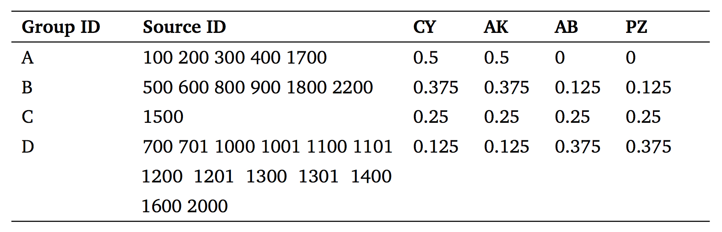
GMPE Selection – Weighting Strategy
We have selected four suitable GMPEs, two per seismotectonic setting:
Chiou & Youngs (2014)
Akkar et al. (2014)
Atkinson & Boore (2006)
Pezeshk et al. (2011)
→ Active Shallow Crust
→ Stable Continental Crust
Four main tectonic categories have then been identified, which allows the assignment of different weight combinations to the GMPEs

Slide 27
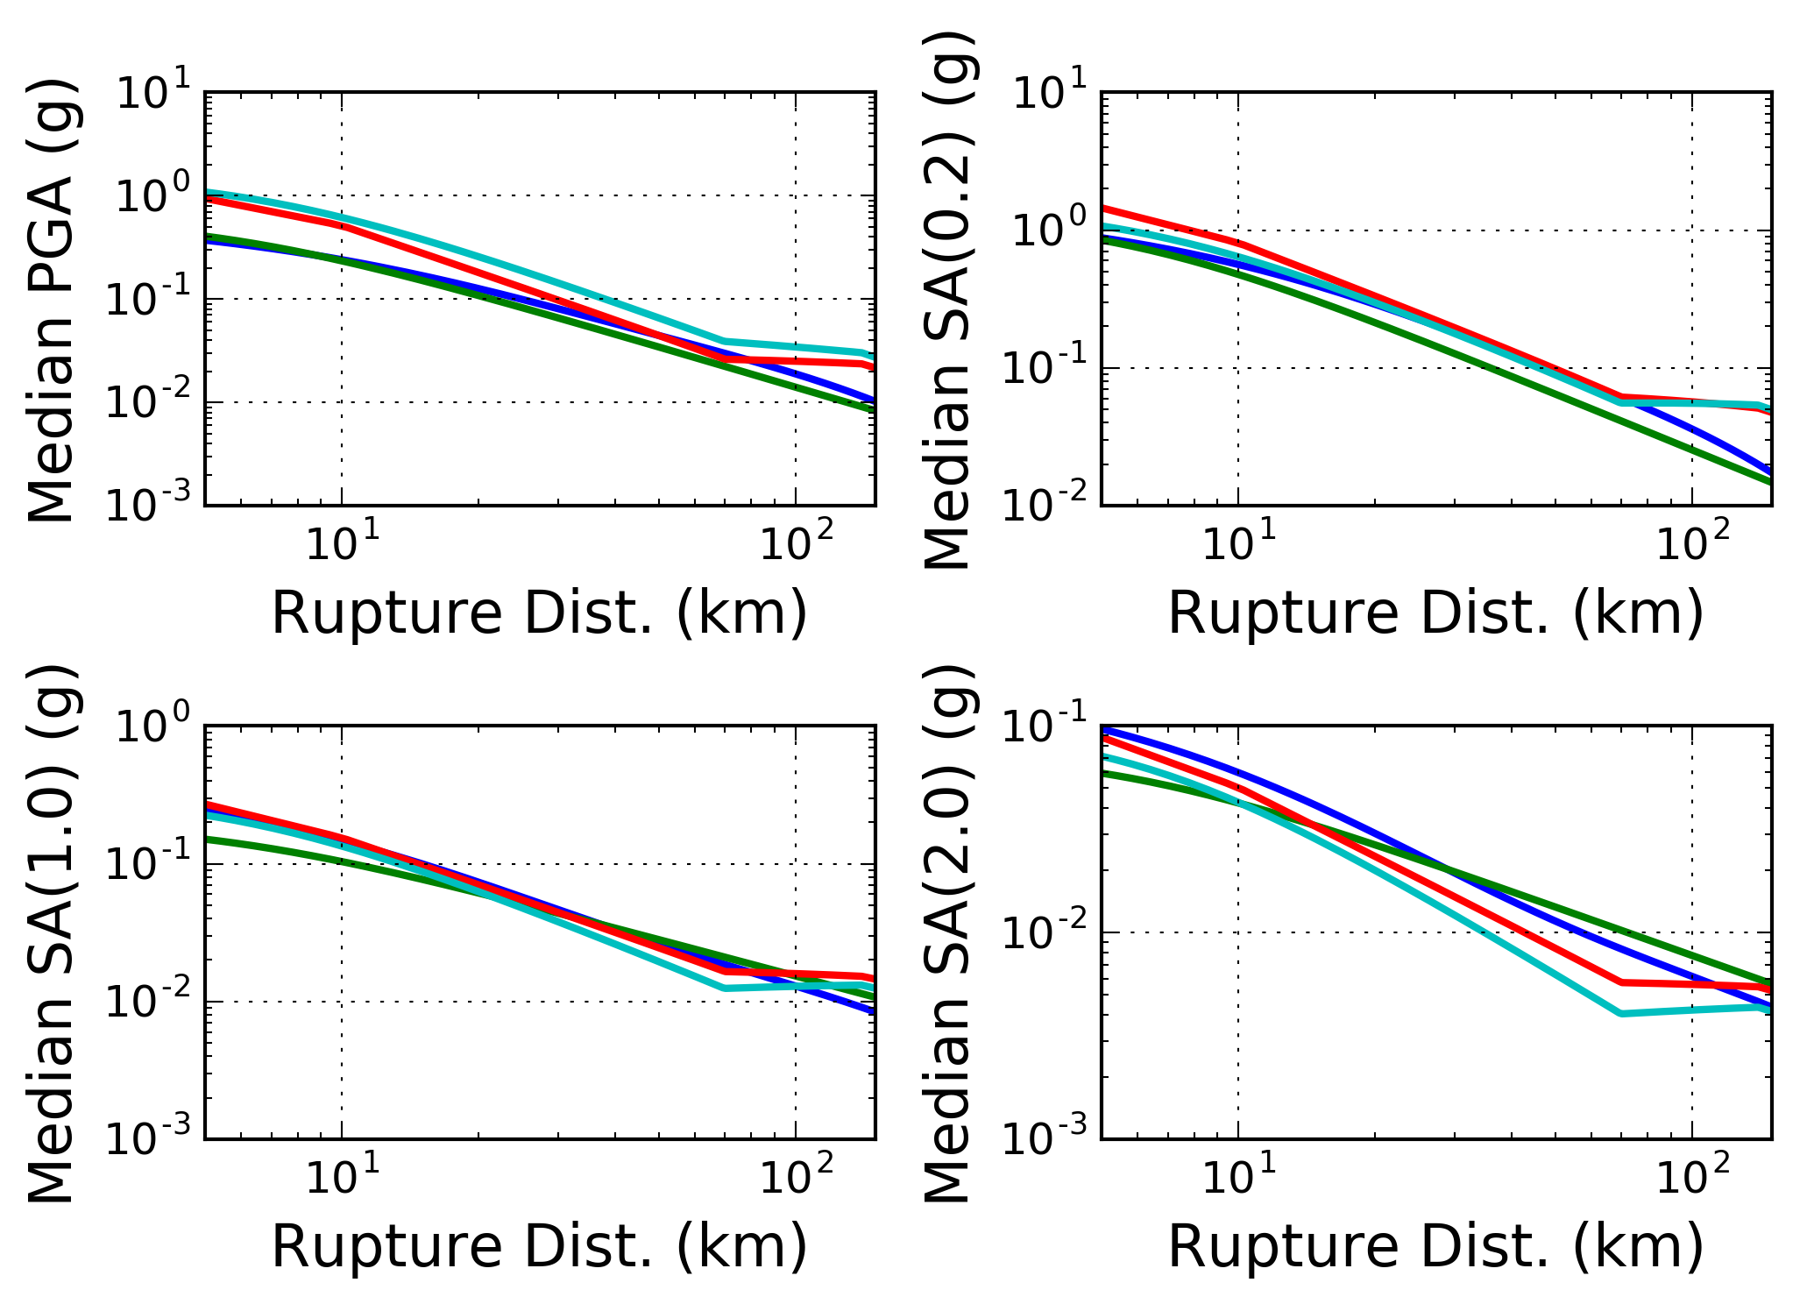
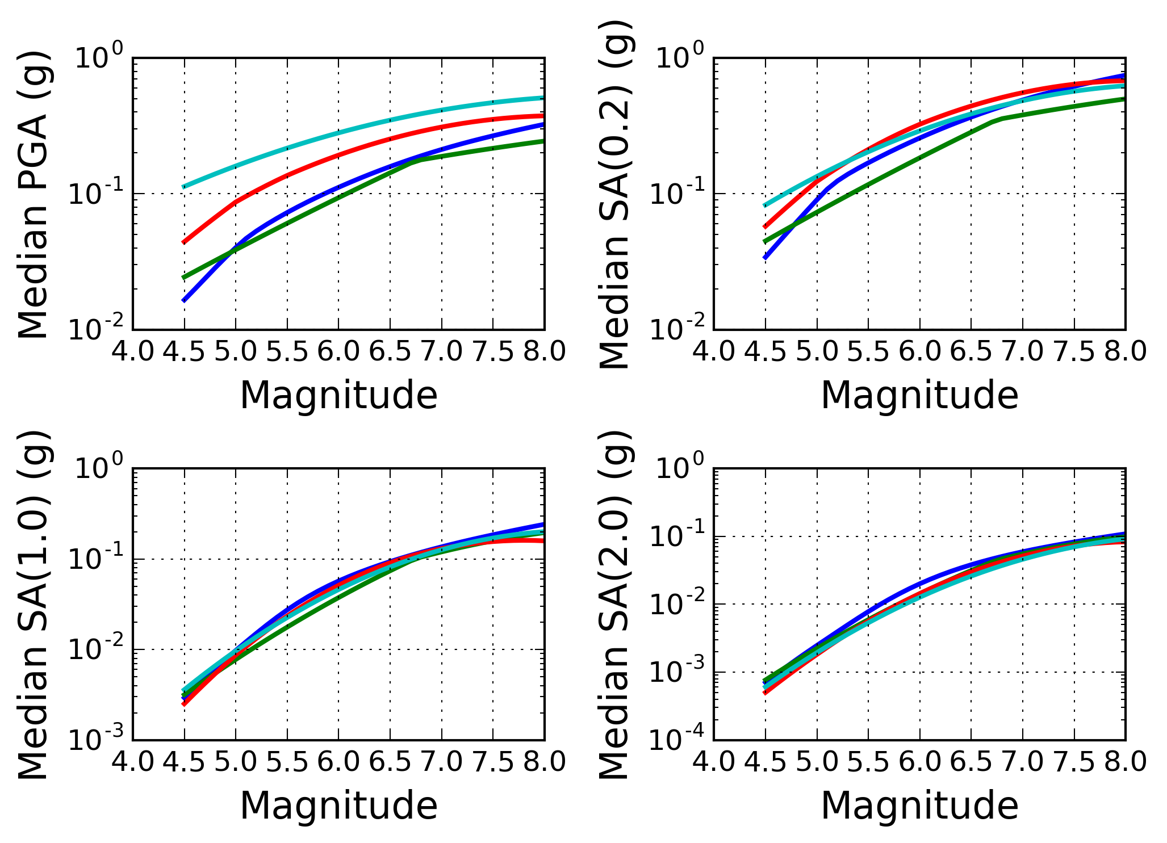
GMPE Selection – Mapping GM Variability
Distance Scaling
The selection was performed with the goal of best representing the epistemic variability of the ground motion models
Magnitude Scaling

Slide 28
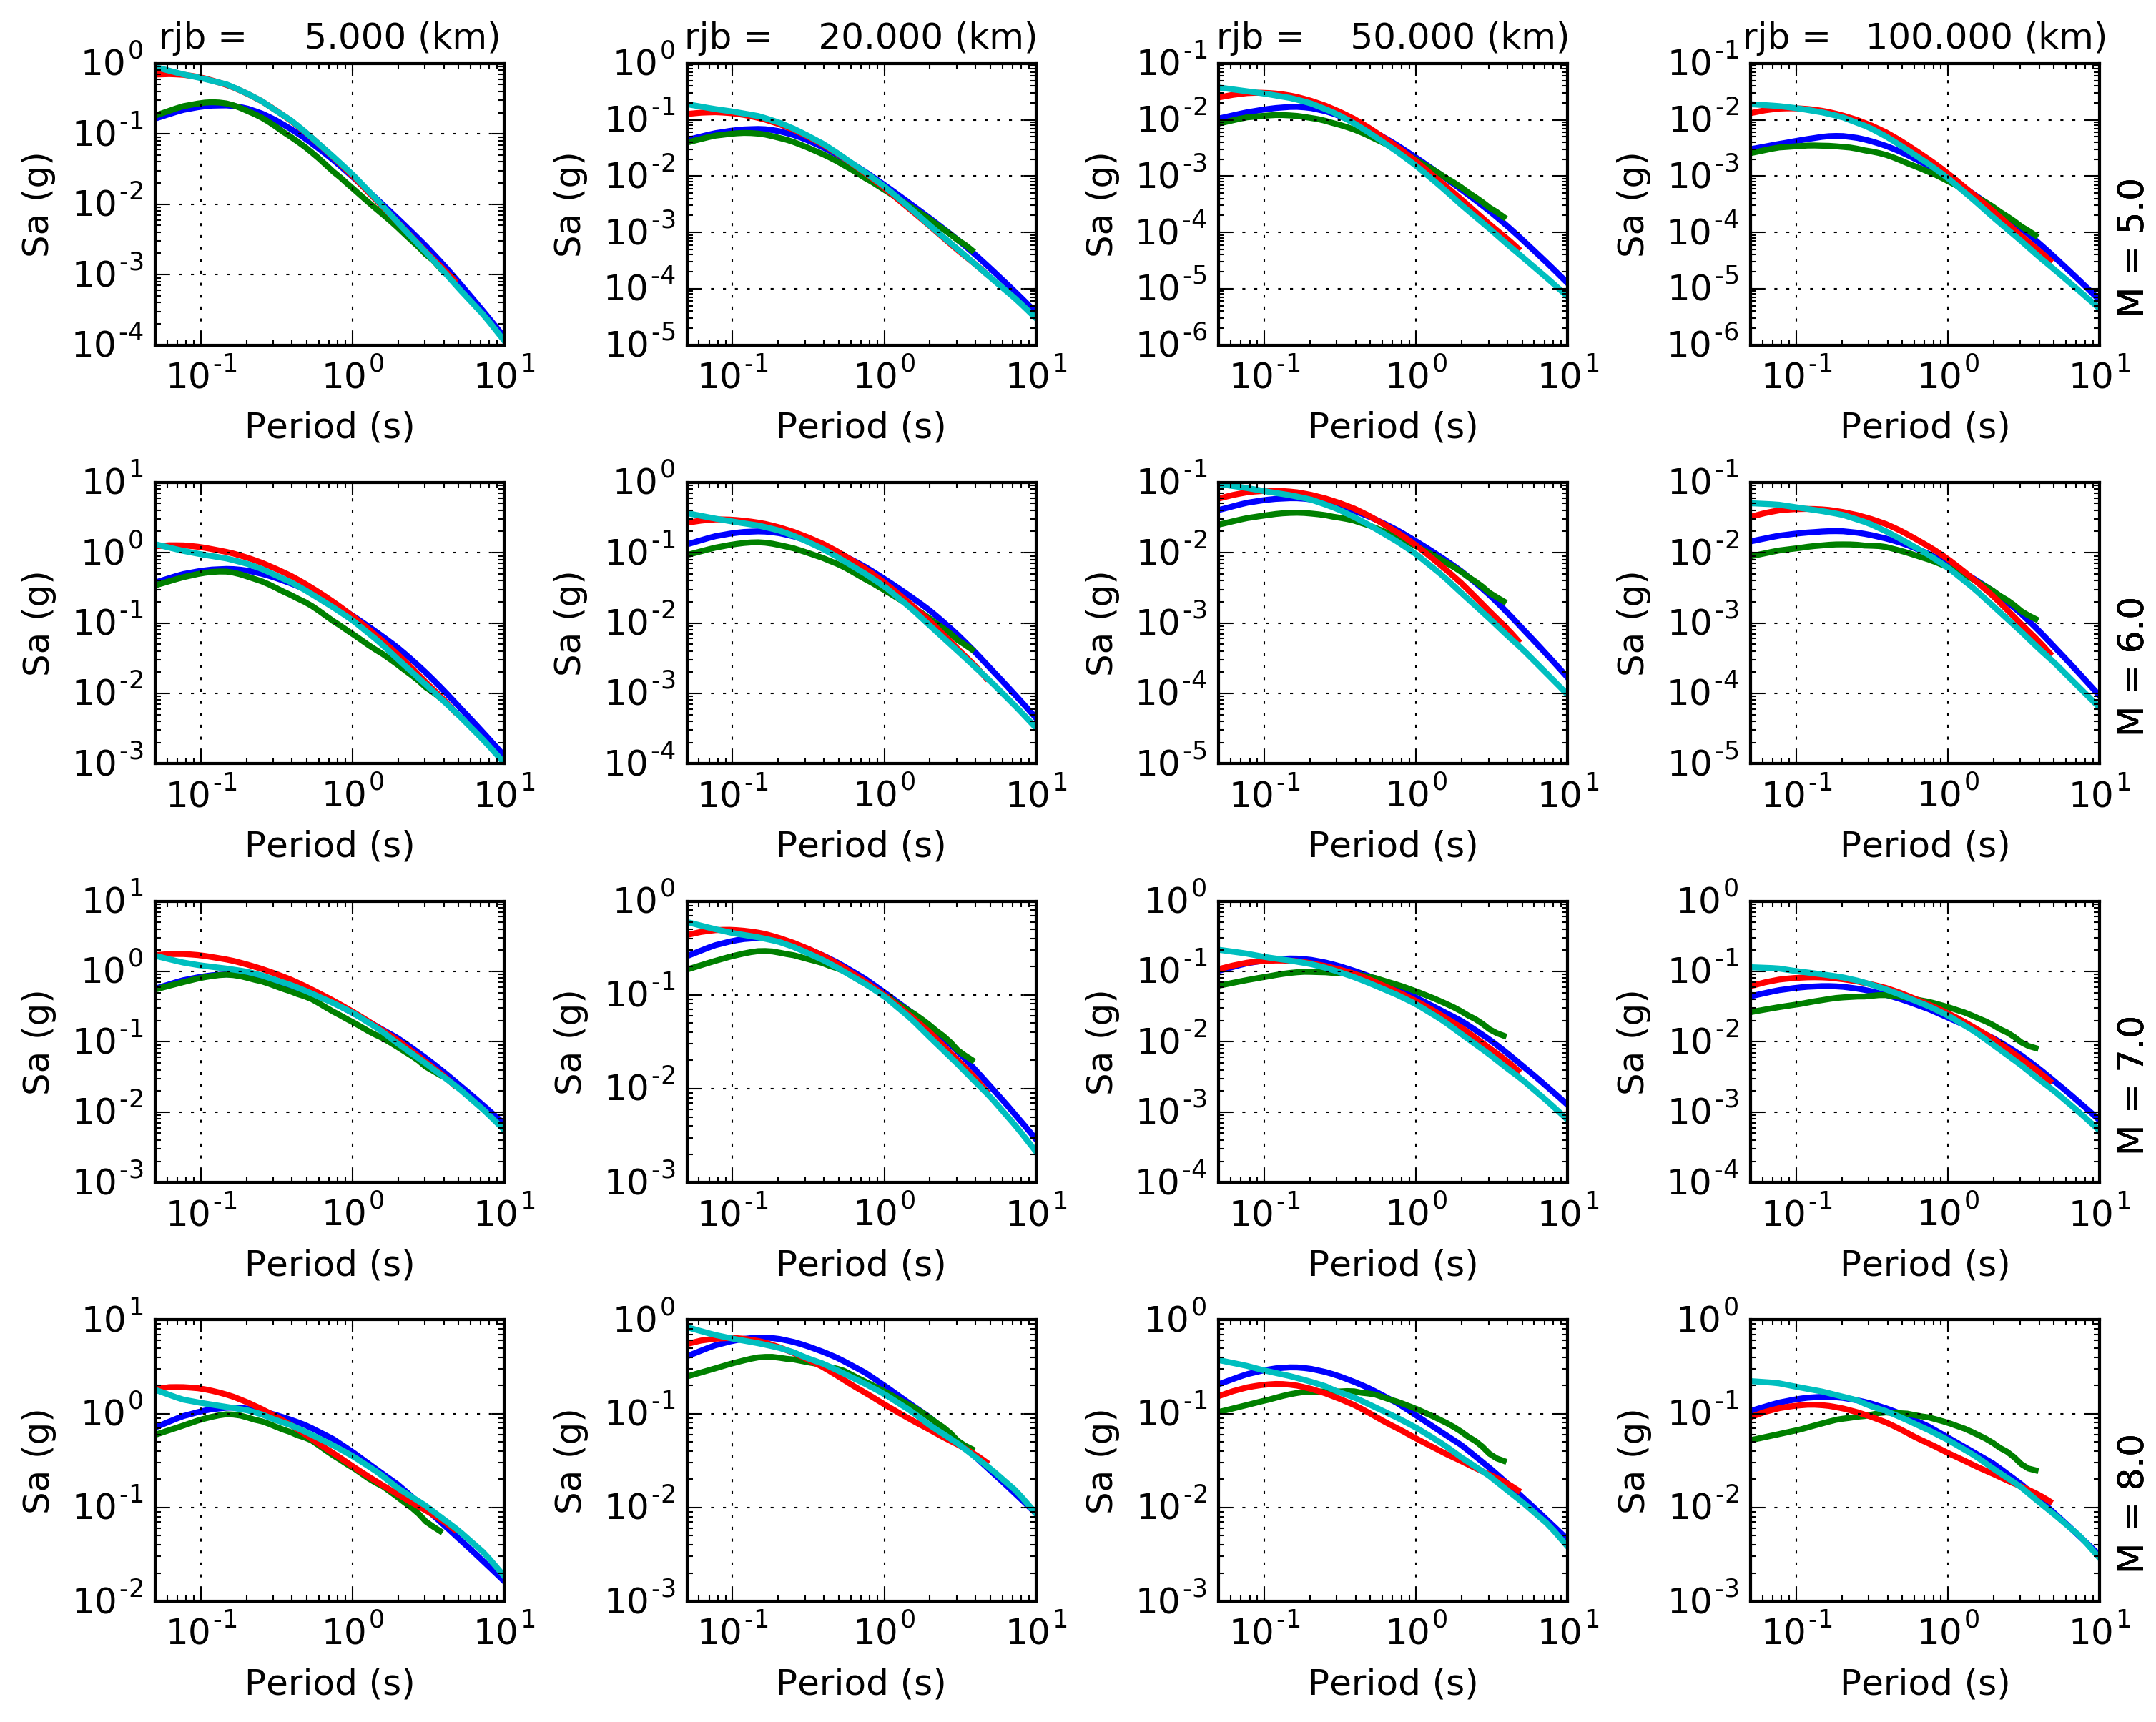
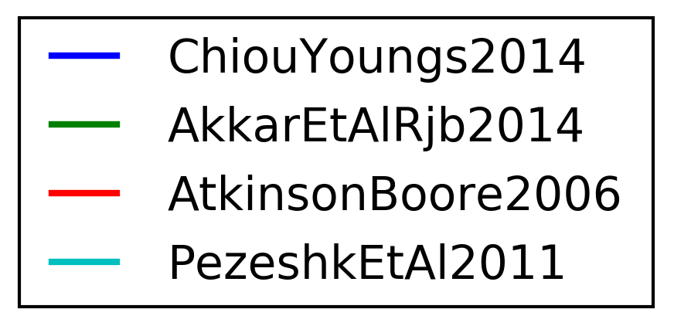
GMPE Selection – Comparing Spectra
Distance (rjb)
Magnitude

Slide 29
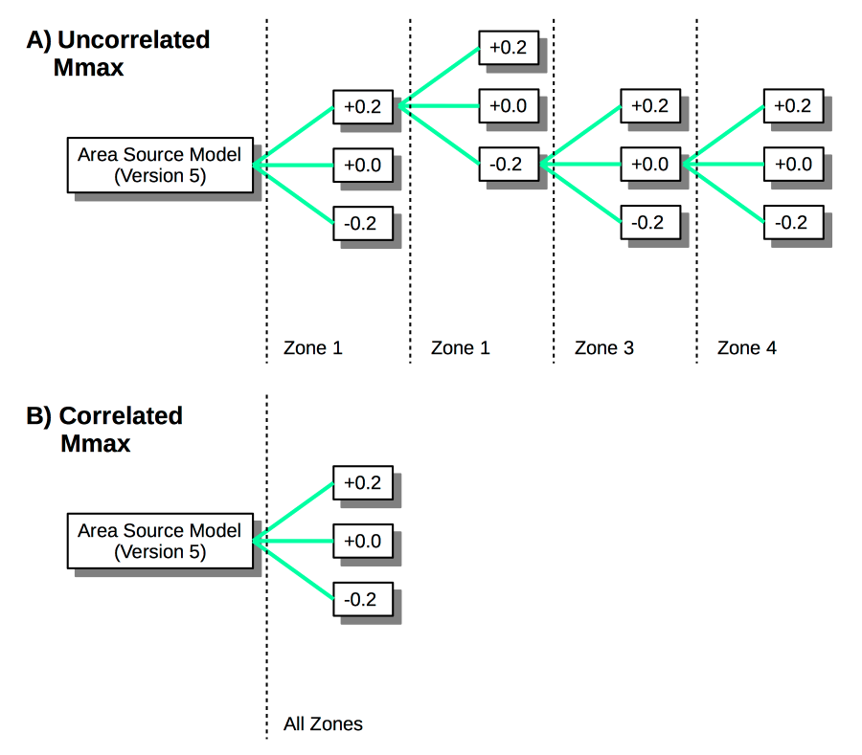
Source Parameter Uncertainty - Regionalization
We only considered uncertainty on M^{max}
What about other sources of uncertainty?

Slide 30
PSHA Results using OpenQuake Engine

Slide 31
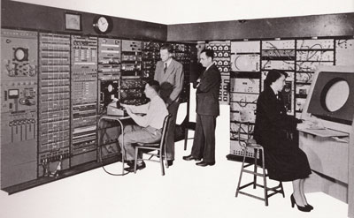
Hazard Calculation Using OpenQuake
The Sub-Saharan Africa Hazard model has been calculated for:
2722 sites (about 50km resolution), 192426 ruptures
2% and 10% PoE in 50 Years (R.P. of 2474 and 474 years, respectively)
Outputs: hazard curves, uniform hazard spectra (UHS), hazard maps
Spectral periods: PGA, 0.05s, 0.1s, 0.2s, 0.5s, 1s and 2s
Statistic: mean hazard and percentiles (0.15, 0.5 and 0.85)
Rock reference conditions (Vs³⁰=600m/s); no site-specific response
6.3 hours on 256 cores

Slide 32
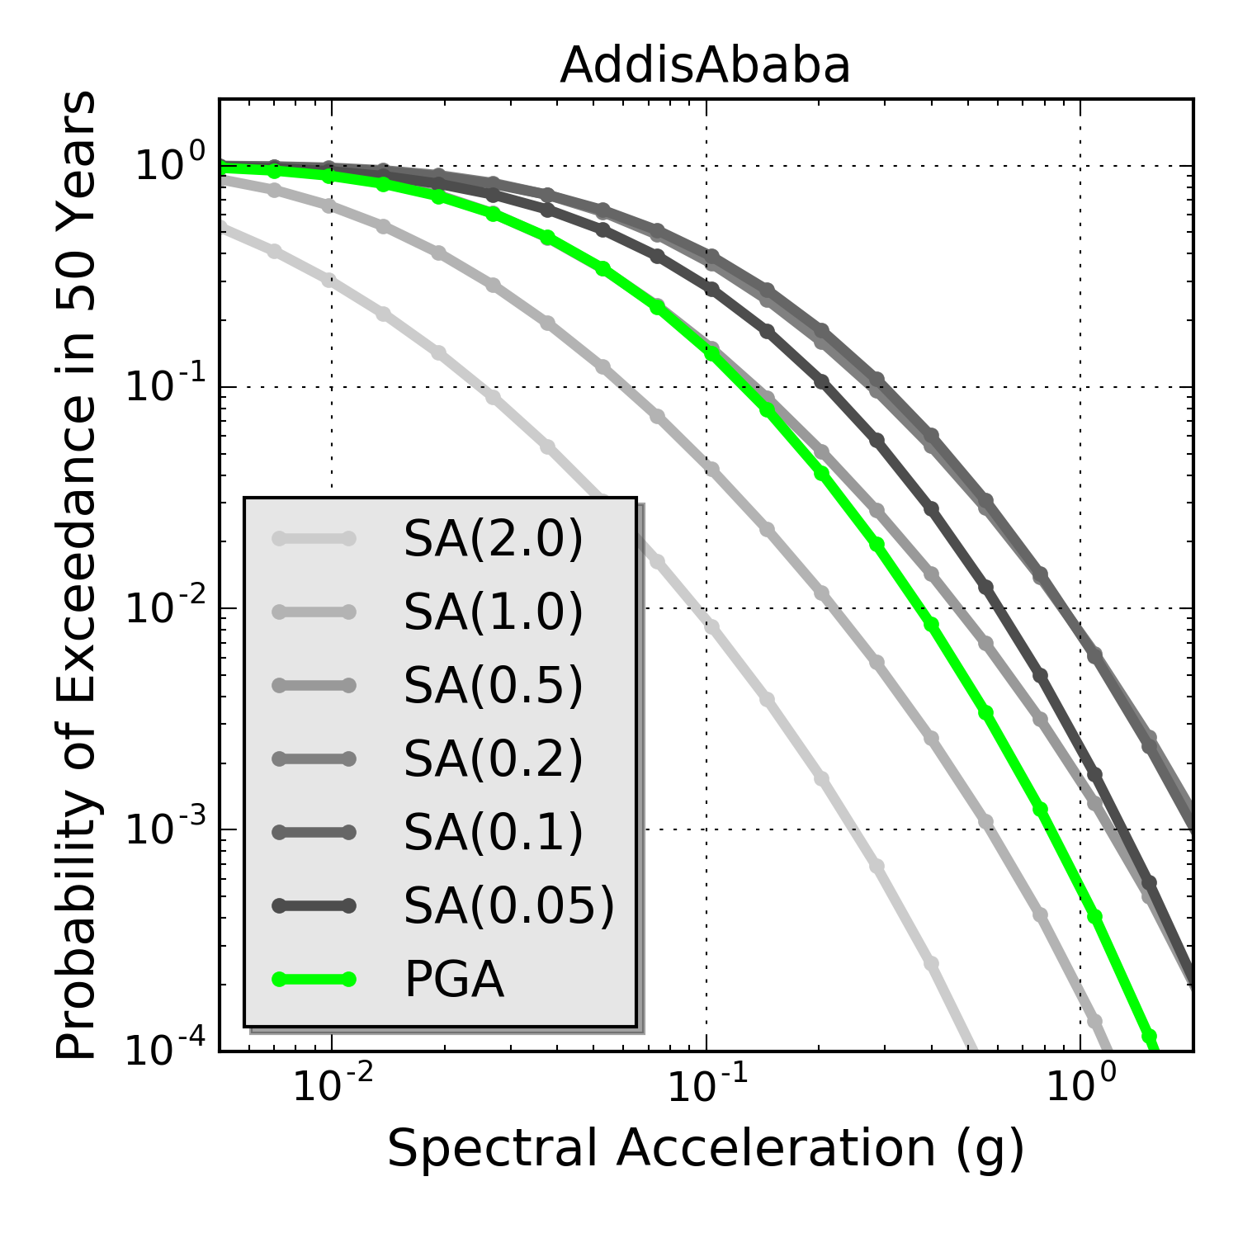
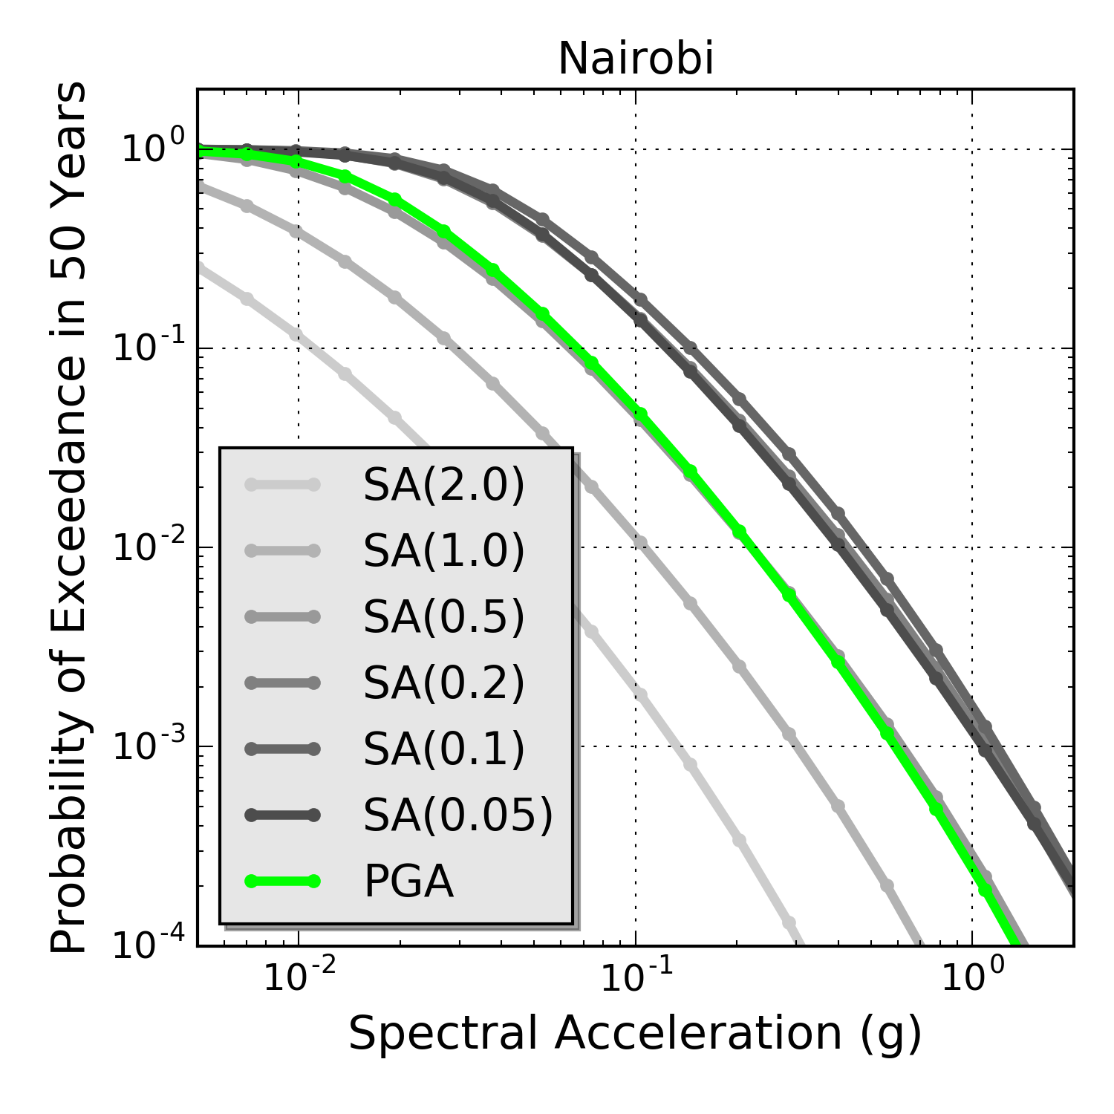
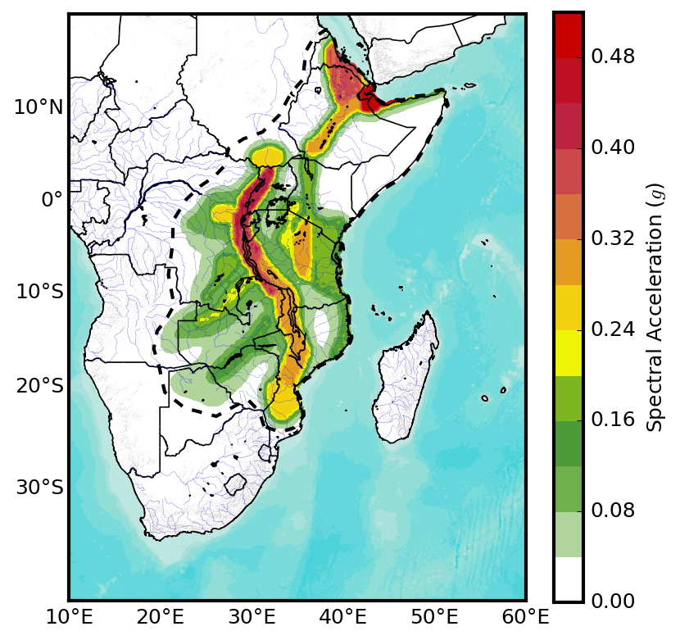
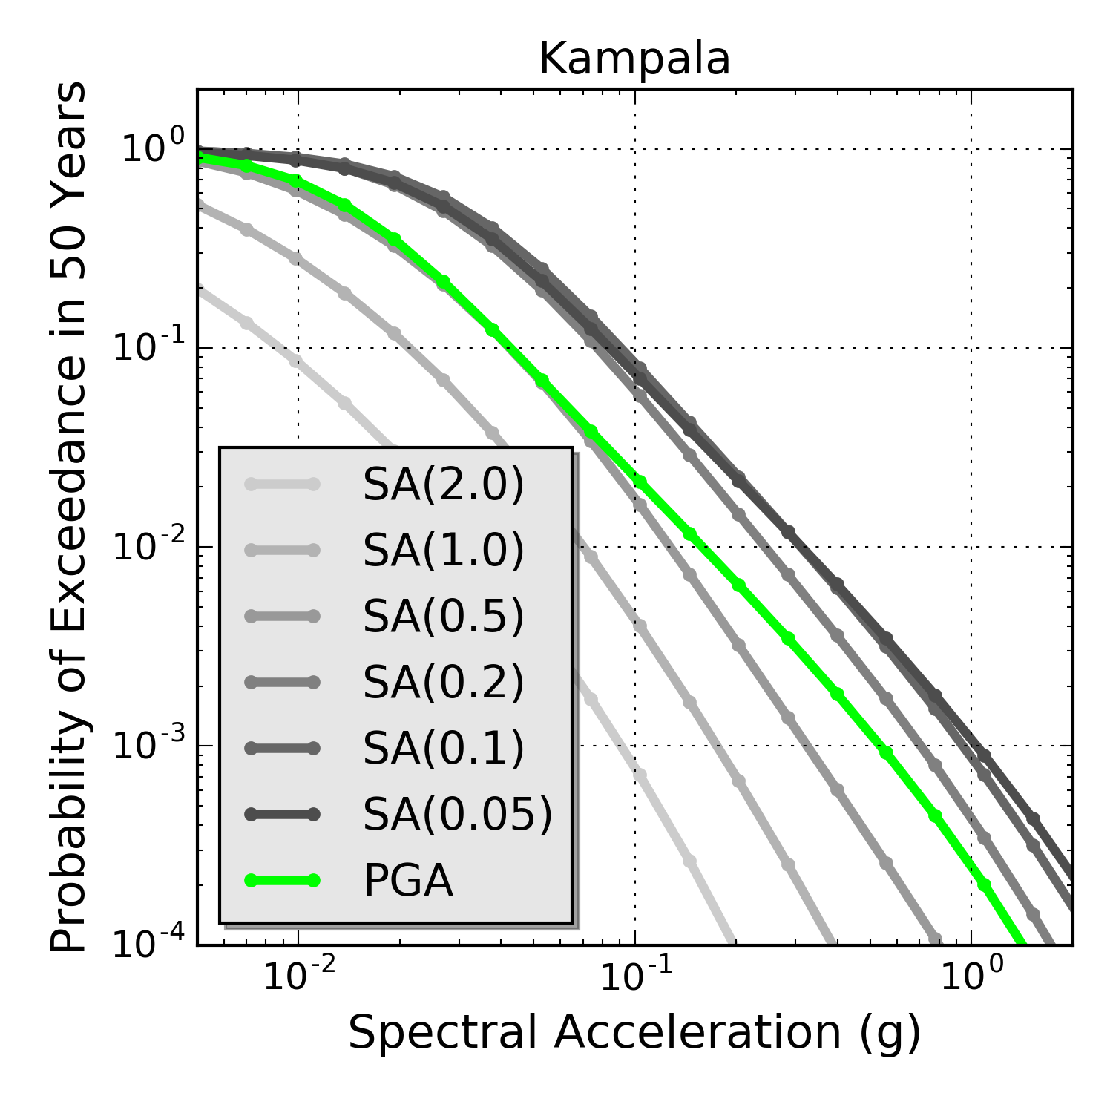
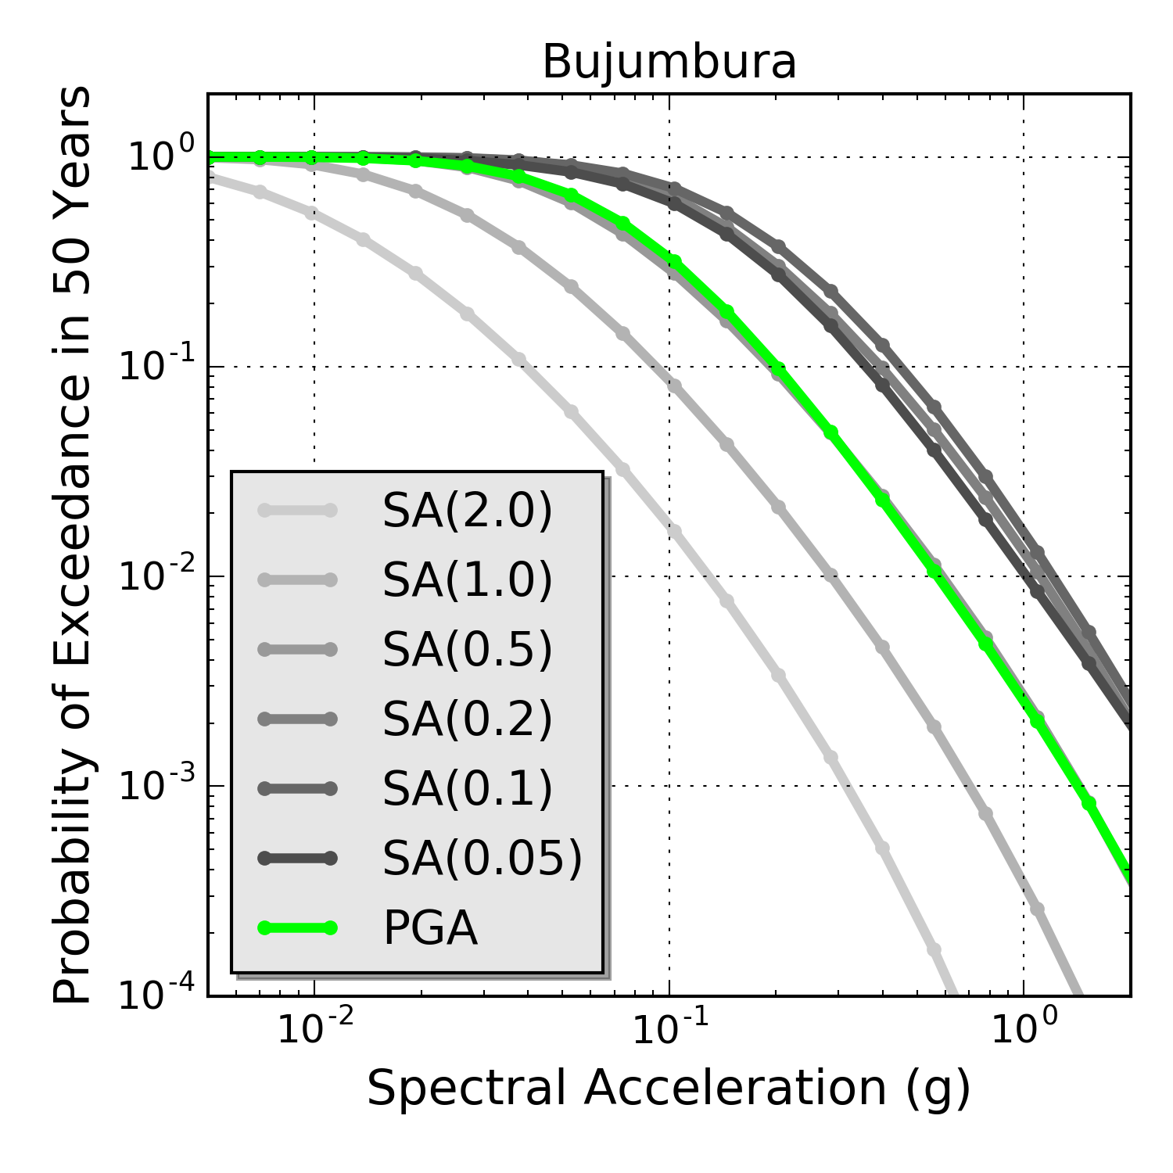
Hazard Curves @ African Capitals
Ethiopia
Kenya
Uganda
Burundi
0.2s
10% POE in 50 years

Slide 33
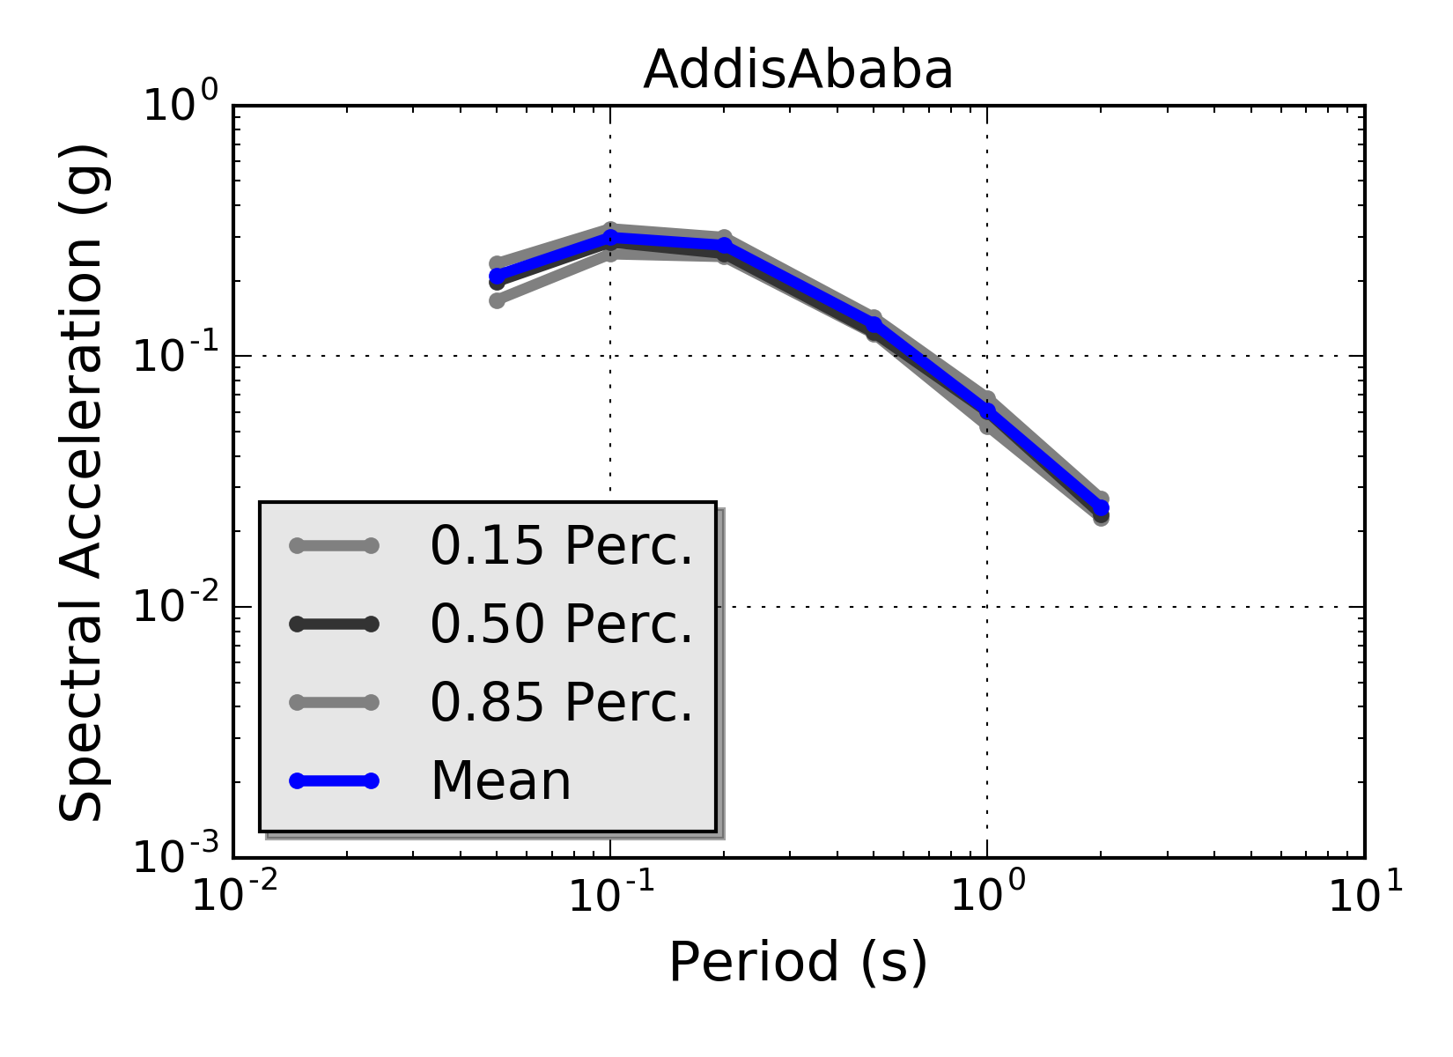
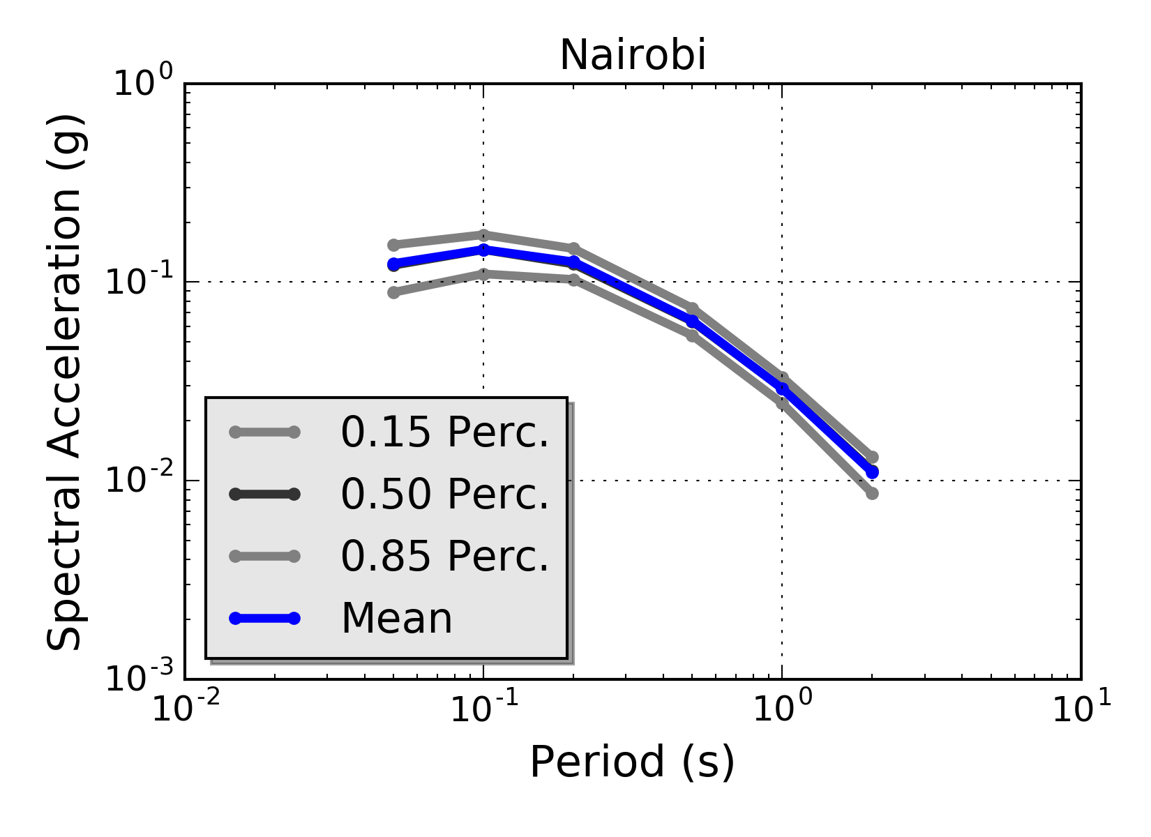
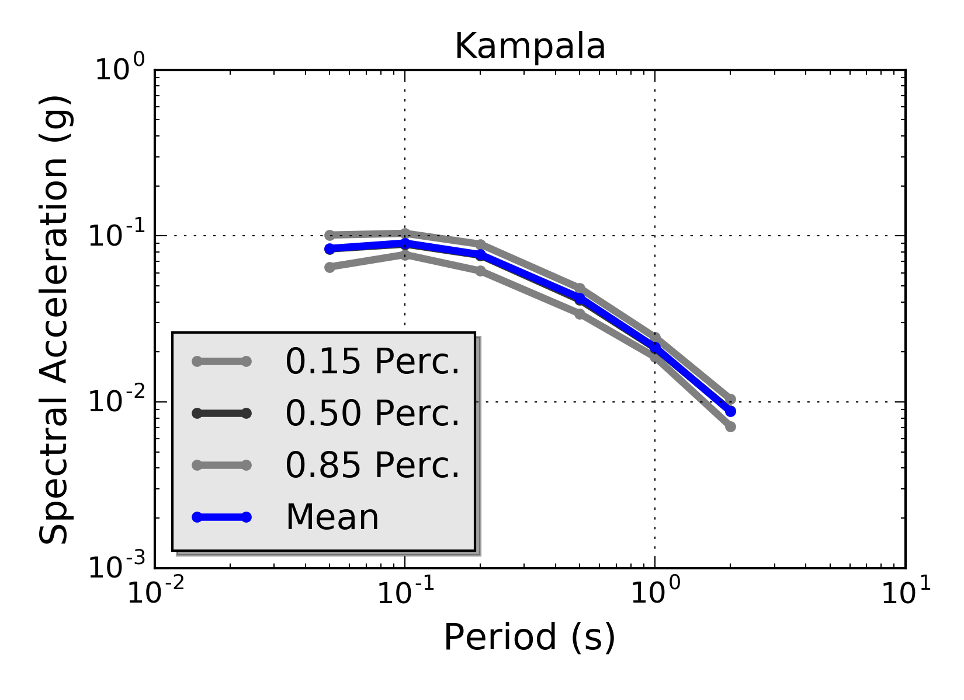
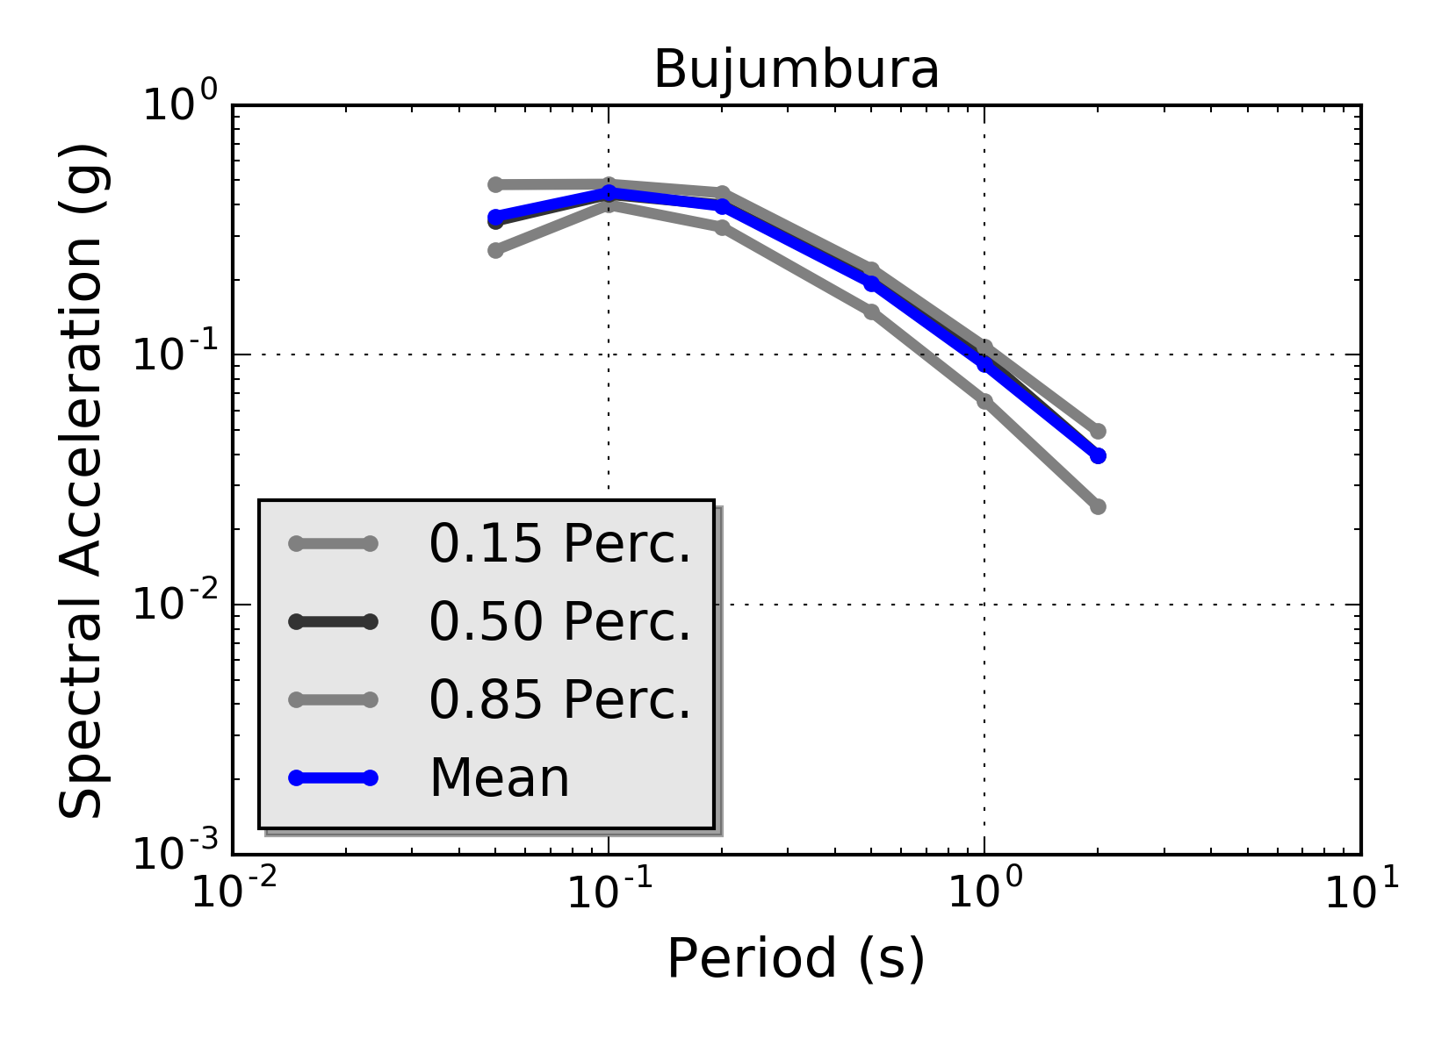
Uniform Hazard Spectra @ African Capitals
Ethiopia
Kenya
Uganda
Burundi
0.2s
10% POE in 50 years

Slide 34
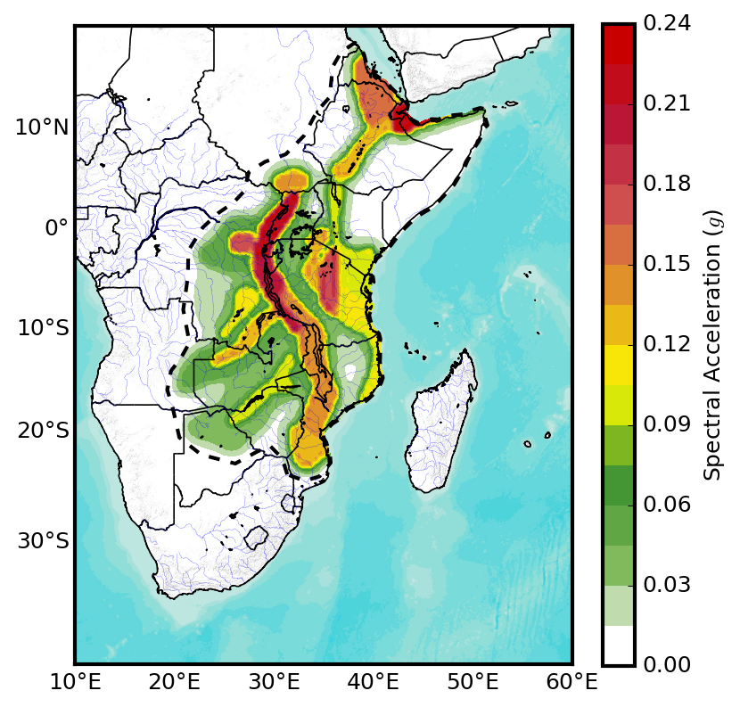
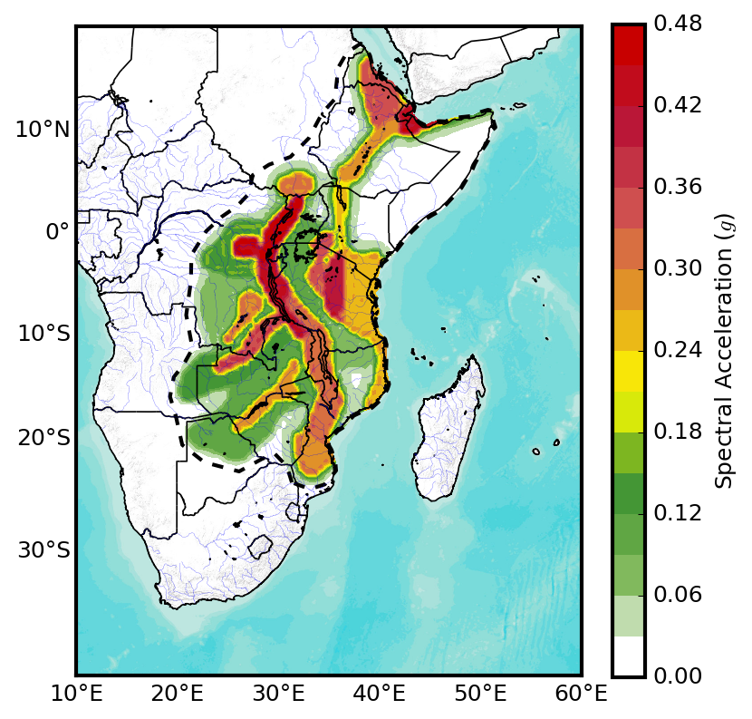
Hazard Maps @ PGA
10% POE in 50 years
2% POE in 50 years

Slide 35

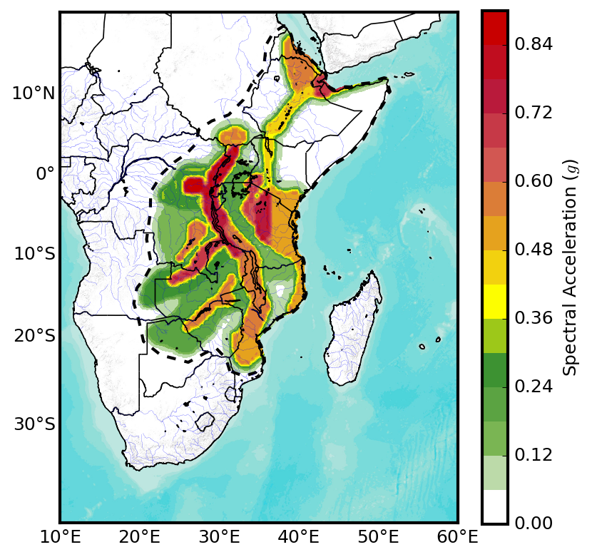
Hazard Maps @ 0.05s
10% POE in 50 years
2% POE in 50 years

Slide 36
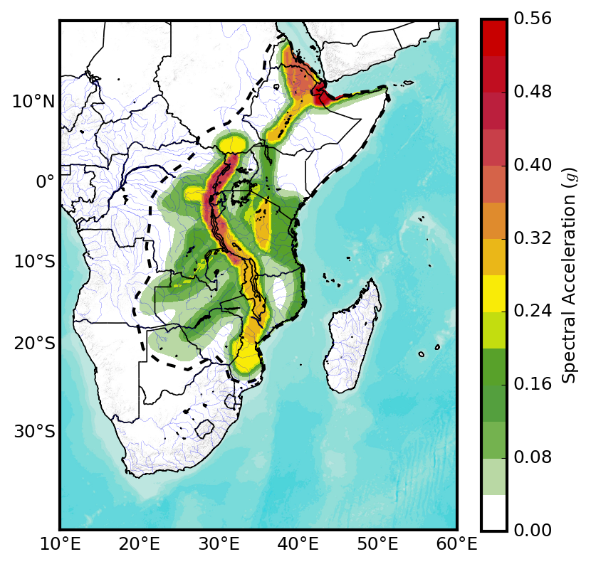
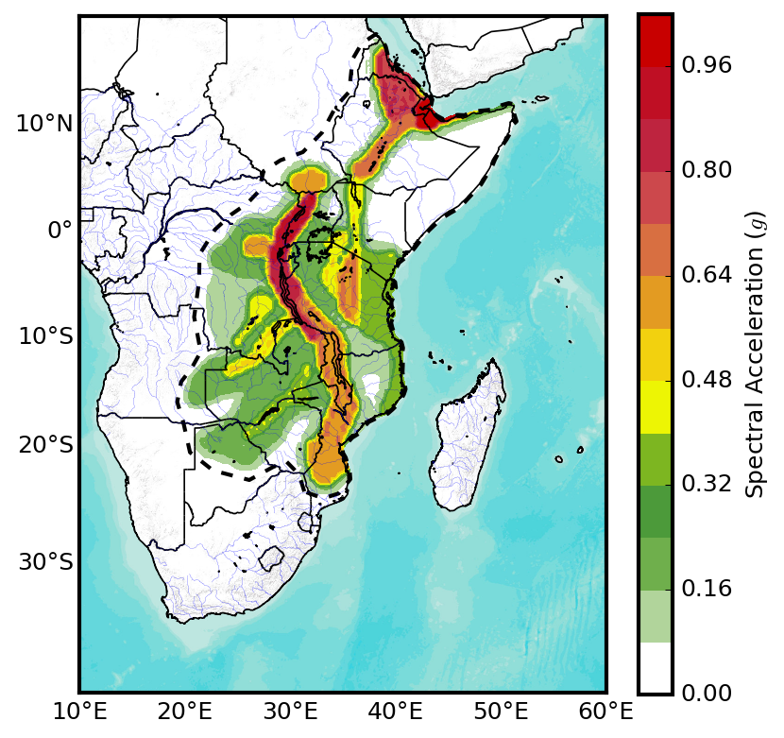
Hazard Maps @ 0.2s
10% POE in 50 years
2% POE in 50 years

Slide 37
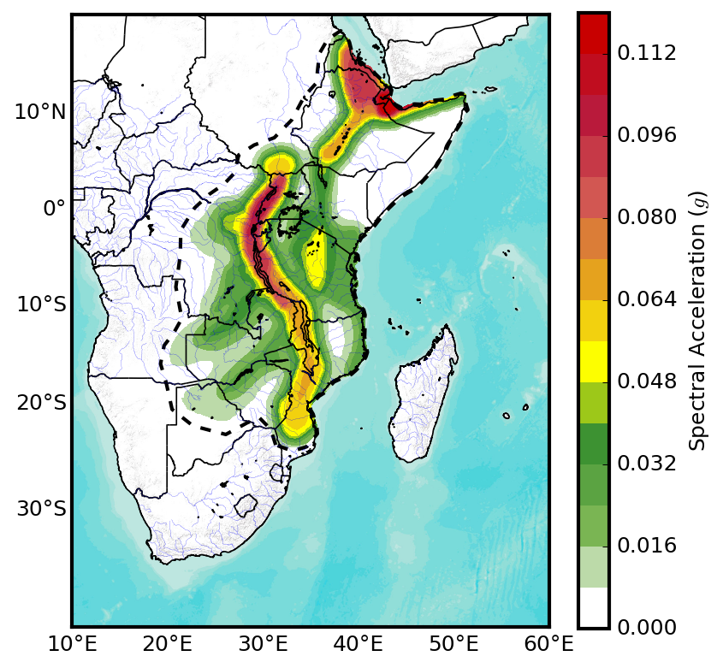
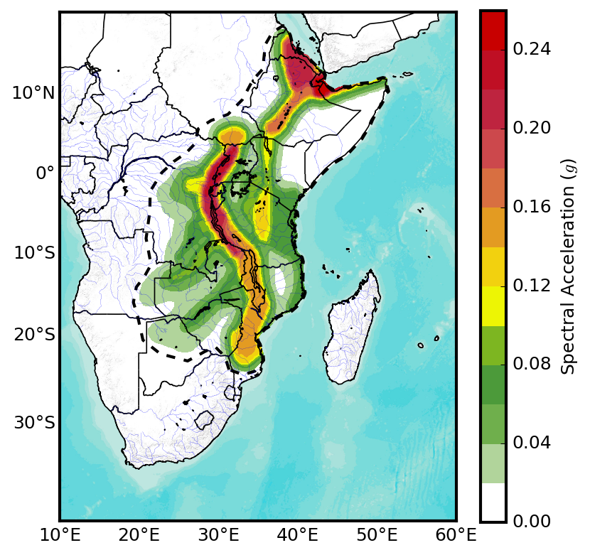
Hazard Maps @ 1s
10% POE in 50 years
2% POE in 50 years

Slide 38
Moving Forward
Although SSA Hazard model has been finalized, several issues still remain open…
Missing PSHA Model Components:
Fault Models ➔ Information is fragmented; how to proceed?
Strain Rates ➔ Strain model already available, but not used so far
Strong Motion Data ➔ AfricaArray, IRIS?
Alternative Seismicity Models ➔ Smoothed Seismicity?
Disaggregation Scenario ➔ Focusing on major cities? Ongoing…..
Site-specific response ➔ Possible microzonation studies?
Food for thought…

Slide 39

Thank you!
Except where otherwise noted, this work is licensed under https://creativecommons.org/licenses/by-nc-nd/3.0/
Please attribute to the GEM Foundation with a link to
www.globalquakemodel.org

